Slide 1
Insider Dev Tour
#InsiderDevTour
Notes:
Hello and welcome to the first EVER year we are doing the Insider Dev Tour. My name is <insert name here> and I’m <an MVP or PM> and I’m really excited today to present to you some amazing content and share some REALLY fun moments we’ll have on stage today. I want to first start by asking, do we have any Windows Insider in the house today?
I want to first start by saying a BIG thank you! With your amazing feedback it would have not of been possible to build such a fantastic and tailored Windows experience.
#WindowsInsiders are the biggest community of people using tech to make a lasting impact in the world. Join us today! Insider.windows.com

Slide 2

#InsiderDevTour
Notes:
Insider Dev Tour is coming to over 40 cities around the world
Twitter hashtag is #InsiderDevTour

Slide 3
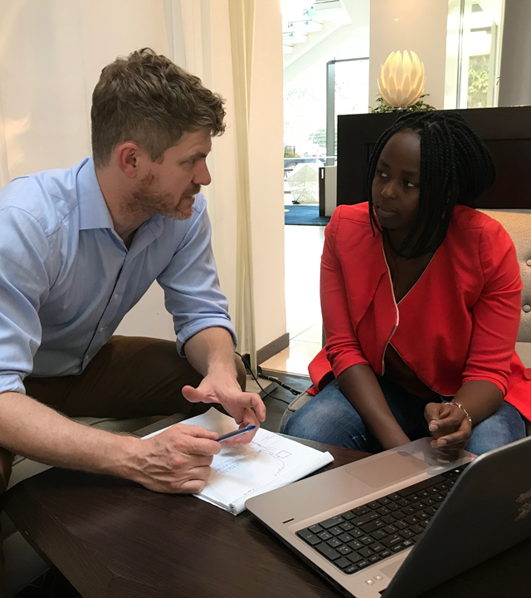
Do you want….
A crystal ball about the future of technology?
To get more engaged customers for your business?
Notes:
An opportunity as developers to see what’s coming in Windows releases before they hit mass market
Prepare your apps and business to take advantage of the latest and greatest

Slide 4
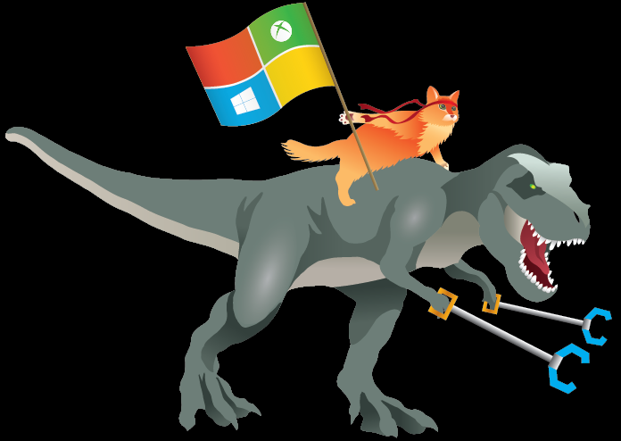
Welcome to the Windows Insider Program!
15 million global passionate tech enthusiasts (yes, even in Antarctica!)
Previewing gen→next of Microsoft products before everyone else
Giving us real-time feedback to make better products for everyone

Slide 5

Today we want YOU to join us
We want YOUR feedback on Windows to make sure we are building what YOU need
We want you to try out the SDK before public launch so YOU know what’s coming next
insider.windows.com
Notes:
Join us, your feedback is important.
Insider.windows.com

Slide 6
How to run your own insider program
OS Builds Rings
App Flighting Experiments
Feedback Hub Triage View
App Integration with FB Hub Dev Center View
Feedback Hub Email & SIUF
Feedback Hub Email & App Notifications
Respond
Feedback
Flight
Community
Twitter Cohorts
App Dev Cohorts
aka.ms/ifDEVthenINSIDER
Notes:
Join us, your feedback is important.
Insider.windows.com

Slide 7


Microsoft Mission
Empower every person
and every organization on the planet
to achieve more
Notes:
Love working with Microsoft because of mission statement to empower everyone
Microsoft really believe that their success is tied to YOUR success.

Slide 8
Azure
Stack
IoT Edge
Sphere
AI & ML
Microsoft 365
Apps
Web
Office
Graph
Notes:
- This opening session will focus on driving your success using our 2 massive platform opportunities.
- One Microsoft Azure and the other Microsoft 365. Both are shaped by one major shift in the technology paradigm.

Slide 9
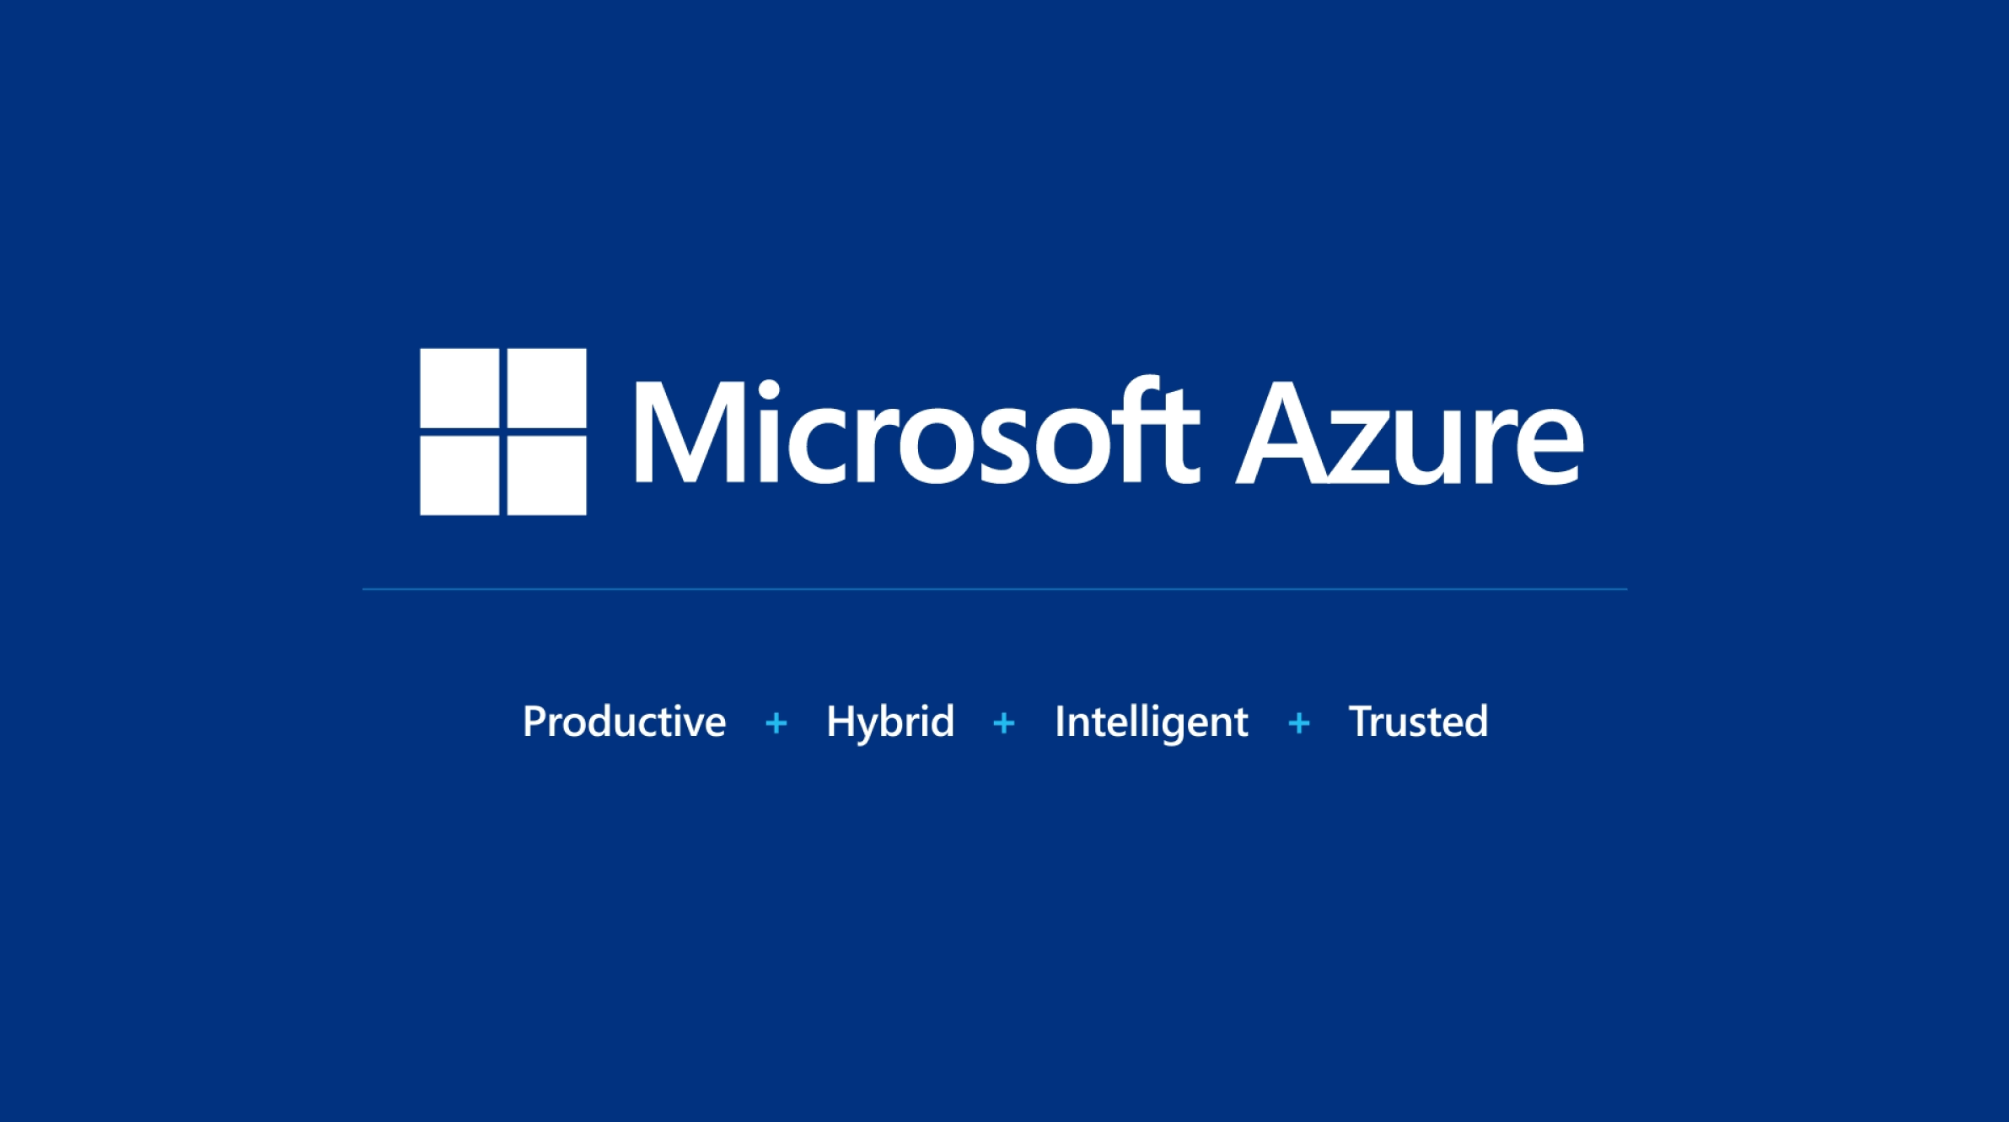
Notes:
Microsoft Azure designed with 4 pillars
Increased Productivity
Flexibility through Hybrid solutions
Intelligence through the cloud
Trusted computing

Slide 10
Azure:
the world’s computer
Notes:
Azure is the worlds computer
over 50+ regions
70+ certifications,
more regions and certifications than any other public cloud…..And that’s so we can meet the REAL world needs of our customers. Their digital sovereignty and their privacy needs.

Slide 11


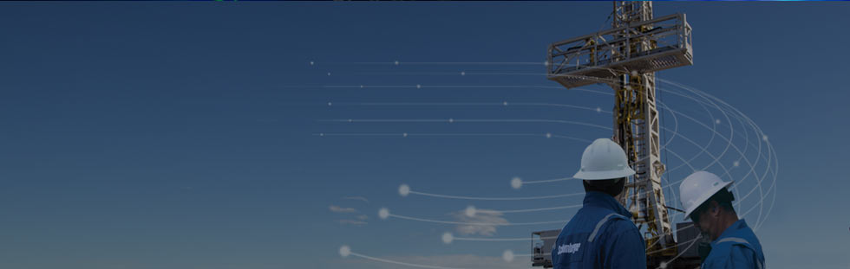
Edge and disconnected
Azure Stack
Regulatory requirements
Distributed cloud applications
Notes:
There various reasons organizations can’t make to the cloud
privacy or regulatory.
Azure Stack gives you the benefits of Azure on the edge inside your own data centers
Companies can utilize distributed cloud systems to get the best of both. Most of the compute is done in the cloud, and where they can’t move things to the cloud they use Azure Stack.

Slide 12
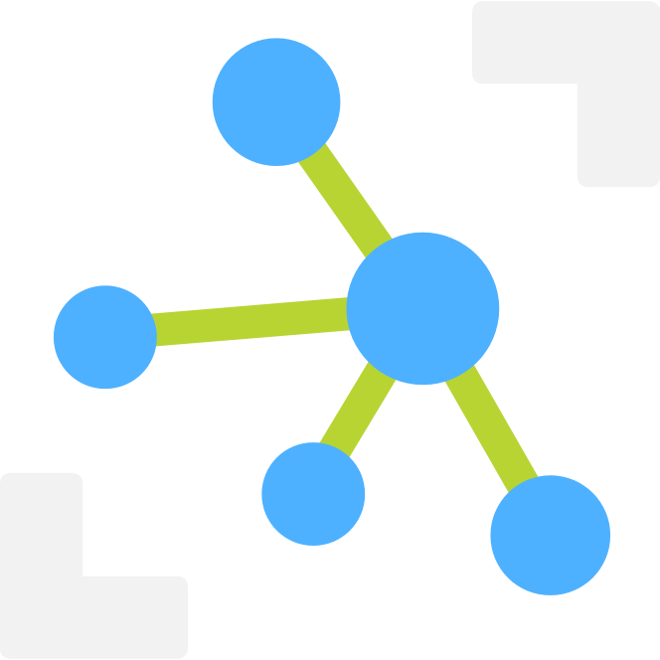
Azure IoT Hub
Securely manage billions of IoT Devices
Works with any IoT Device
Telemetry ingestion and command & control
Notes:
Ambient computing is part of our future
Azure IoT Hub provides a secure way to manage IoT devices
Scales to works with any IoT device
Provides Monitoring through telemetry ingestion and command and control

Slide 13
Azure IoT Hub
Demo
Notes:
Let’s jump into a demo and show you just how easy it is to implement an IoT solution.
(7 minutes)

Slide 14

Azure IoT Edge
Azure loT Hub
Azure Function
PUSH
Notes:
Explanation of demo
- The button gets the configuration from Azure IoT Hub.
- The button passes data to the Azure IoT Hub
- The Azure IoT Hub routes the call to the Azure function which executes code in App logic

Slide 15
Azure IoT Edge
Azure loT Hub
PUSH
Notes:
Explanation of demo
- The button gets the configuration from Azure IoT Hub.
- The button passes data to the Azure IoT Hub
- The Azure IoT Hub routes the call to the Azure function which executes code in App logic

Slide 16

Azure IoT Edge
Supports Windows and Linux devices
Reliably deploy apps using containers
Supports Azure ML, Functions, Streaming Analytics
End-to-end security from device to cloud
Open Source Now
Notes:
Azure IoT Edge
Support Windows and Linux devices
Using container technology like Docker to manage deployment of apps
Support some of the great features like Azure ML, Azure functions and Streaming Analytics
End-to-end security from device to cloud
For your customize your solutions we are now open sourcing Azure IoT Edge

Slide 17
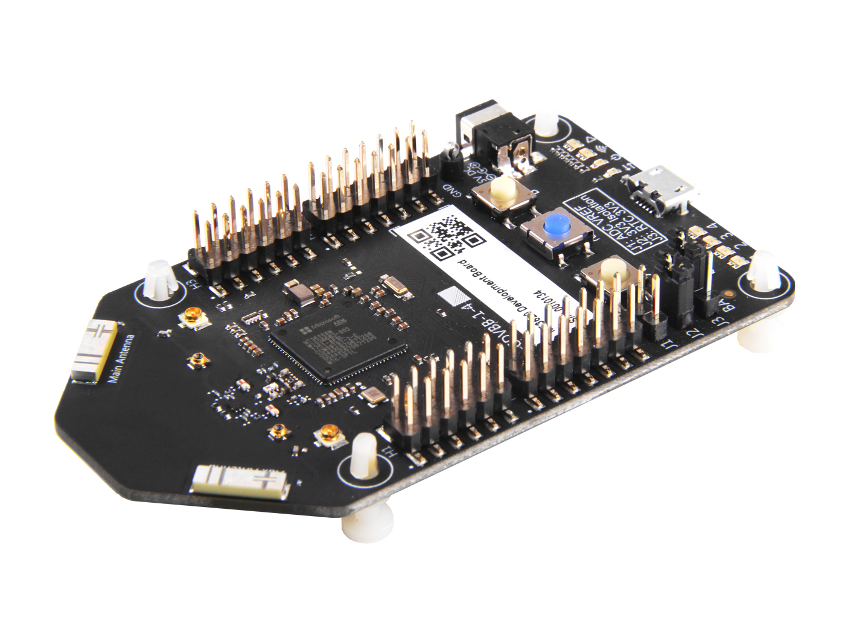
Cloud Security
Azure Sphere
Azure Sphere
Secured MCU
Secured OS
Notes:
- Secure Silicon design
Secure OS
Management Services
9 Billion Microcontrollers that ship each year – a lot of developer opportunity

Slide 18


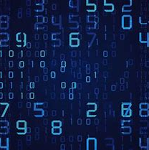
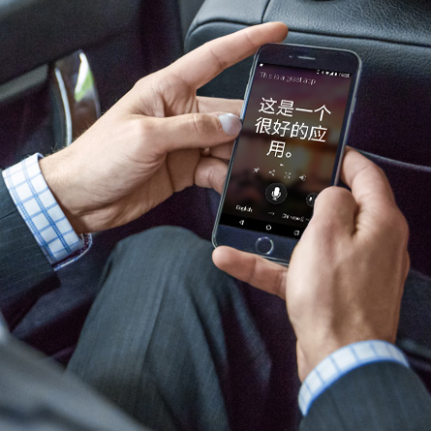
Microsoft AI breakthroughs
Switchboard
Meeting speech
96%
RESNET vision test 152 layers
5.1%
Switchboard speech recognition test
88.5%
SQuAD reading comprehension test
69.9%
MT research system
Broadcast speech
Switchboard cellular
IBM Switchboard
1993
2000
2006
2010
2017
2016
Object recognition Human parity
2017
Speech recognition Human parity
January 2018
Machine reading comprehension Human parity
March 2018
Machine translation Human parity
Notes:
- Microsoft has had made many breakthroughs over the last couple of years
- What’s important is to simplify this into tools, libraries and services that are easy to consume for developers

Slide 19
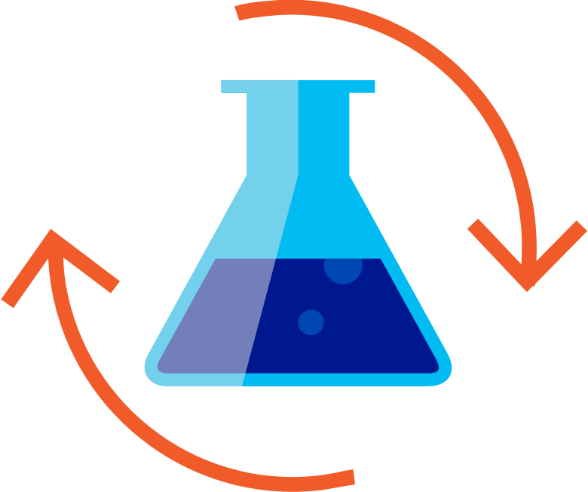

Get started with machine learning
Prepare Data
Build & Train
Deploy
Azure Databricks
Azure Machine Learning
In the cloud – on the edge
Quickly launch and scale Spark on demand
Rich interactive workspace and notebooks
Seamless integration with all Azure data services
Broad frameworks and tools support: TensorFlow, Cognitive Toolkit, Caffe2, Keras, MxNET, PyTorch
Docker containers
Windows Machine Learning
Notes:
- Microsoft has been investing in AI solutions for a while, and they have worked with developers across industries who use AI solutions.
[1]
- Machine Learning is a power tool to help us answer specific questions.
- We need to understand what question we’re striving to bring clarity to.
- Once we’ve defined the question we want to answer, we must identify a set of labelled data which can help us answer this question.
- Azure Databricks combines the best of Databricks and Azure to help customers accelerate innovation with one-click set up, streamlined workflows, and an interactive workspace that enables collaboration between data scientists, data engineers, and business analysts.
[2]
- Azure Machine learning allows you to use broad frameworks and tools to build and train the model, including frameworks such as TensorFlow, Cognitive Toolkit, PyTorch and more.
- It allows you to scale training to 100Ks servers and use –prebuilt AI model packages for Computer Vision, Text, and forecasting
[3]
- Once you’ve trained a model, you can deploy it to a service to use from the cloud or use it locally on the edge.
For the rest of this talk, we will focus on using pre-trained models on the edge and on Windows

Slide 20
Cognitive Services
Over 1 million developers!
Broad services
Any scenario
Everywhere
Cognition
Custom training
Cloud
Vision
Speech
Language
Knowledge
Search
Custom vision
Custom speech
Custom voice
Custom language
Custom search
Custom translation
On Premises
Mobile devices
IoT
Notes:
Microsoft invested heavily in providing some AI models through cognitive services. Microsoft started this only a few years ago with a couple of services.
Since then, Cognitive Services has had over 1 million developers using our REST endpoints across the variety of services.
Board services, like vision, speech and language
Custom training which you can utilize like, custom voice, custom speech, custom translation.
These models work across a variety of places, like the cloud, on premise and on devices.

Slide 21
Machine learning
Demo
Notes:
A model that was trained in the cloud
Using WinML to do low latency machine learning

Slide 22
Azure
Stack
IoT Edge
Sphere
AI & ML
Microsoft 365
Apps
Web
Office
Graph
Notes:
- This opening session will focus on driving your success through our various platform opportunities.
The two main platforms: Azure and Microsoft 365.
Developer experiences, Whatever flavor of developer you are: an app developer, web developer or an Office developer, we have something for you.
Microsoft Graph is ties all these experiences together

Slide 23


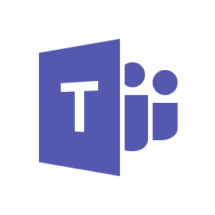
Microsoft 365
Windows
Office
EMS
C o f f e e
Multi-sense
Multi-device
Notes:
Microsoft 365 is the coming together of Windows and Office to bring this multi-sense, multi-device experience. Putting people at the center vs devices at the center.
It’s about our evolution from a PC-based solution to solutions spanning across devices and platform technologies.
This experience and platform will bridge those multi device multi sense gaps elegantly … and via platform that you all can participate in

Slide 24
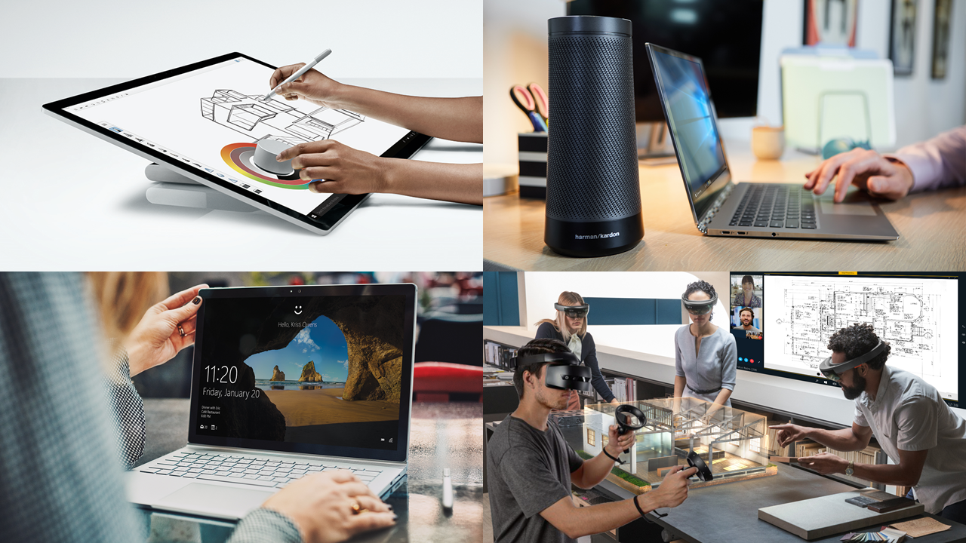
Notes:
Multi-sense
Traditionally we’ve always thought of PC experiences as the mouse and keyboard, it’s now much more!
Ink
Dial
Speech
Windows Hello
Holographic
Let’s show you how we bring the best of multi-sense on one our new flagship collaboration devices. The Surface Hub 2.

Slide 25
Surface Hub 2 video
Notes:
(Wait for Video to Finish)
You can see that the Surface Hub 2 shows you a beautiful devices many interactions
Pen
Touch
Rotation
Speech and Vision
Microsoft 365 is more than just multi-sense. It’s also about multi-device. I want to show you how Windows is a participator among all your devices.

Slide 26
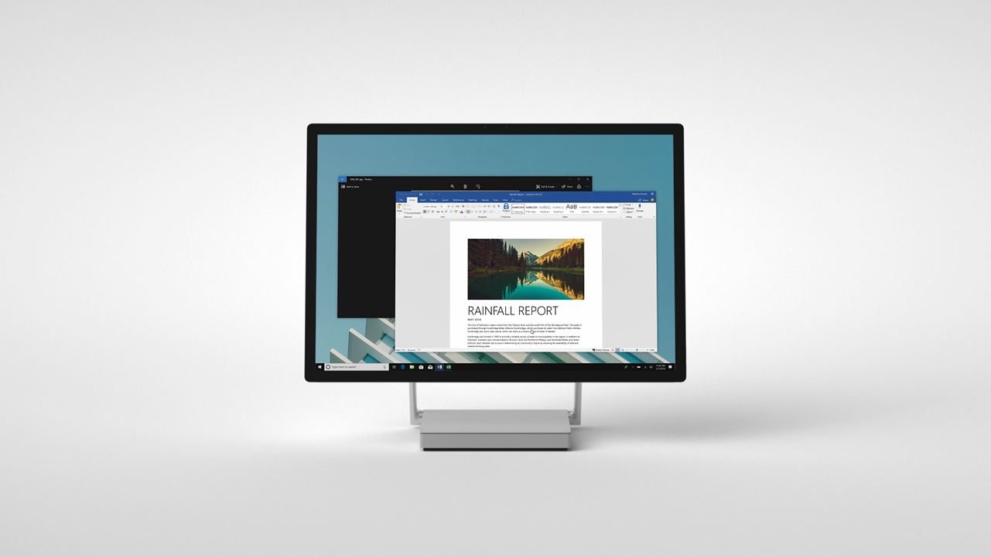
Notes:
Let me give you a couple of examples of Multi devices…including phones

Slide 27
Insert Timeline Video 1 Here
Notes:
- Click the Timeline icon on the start menu or press Win + Tab

Slide 28
Insert Timeline Video 2 Here
Notes:
- You can see all the things that I’ve been working on across my many devices

Slide 29
Insert Timeline Video 3 Here
Notes:
- Here I have an excel spreadsheet I’ve been working on. I can click it to launch it.

Slide 30
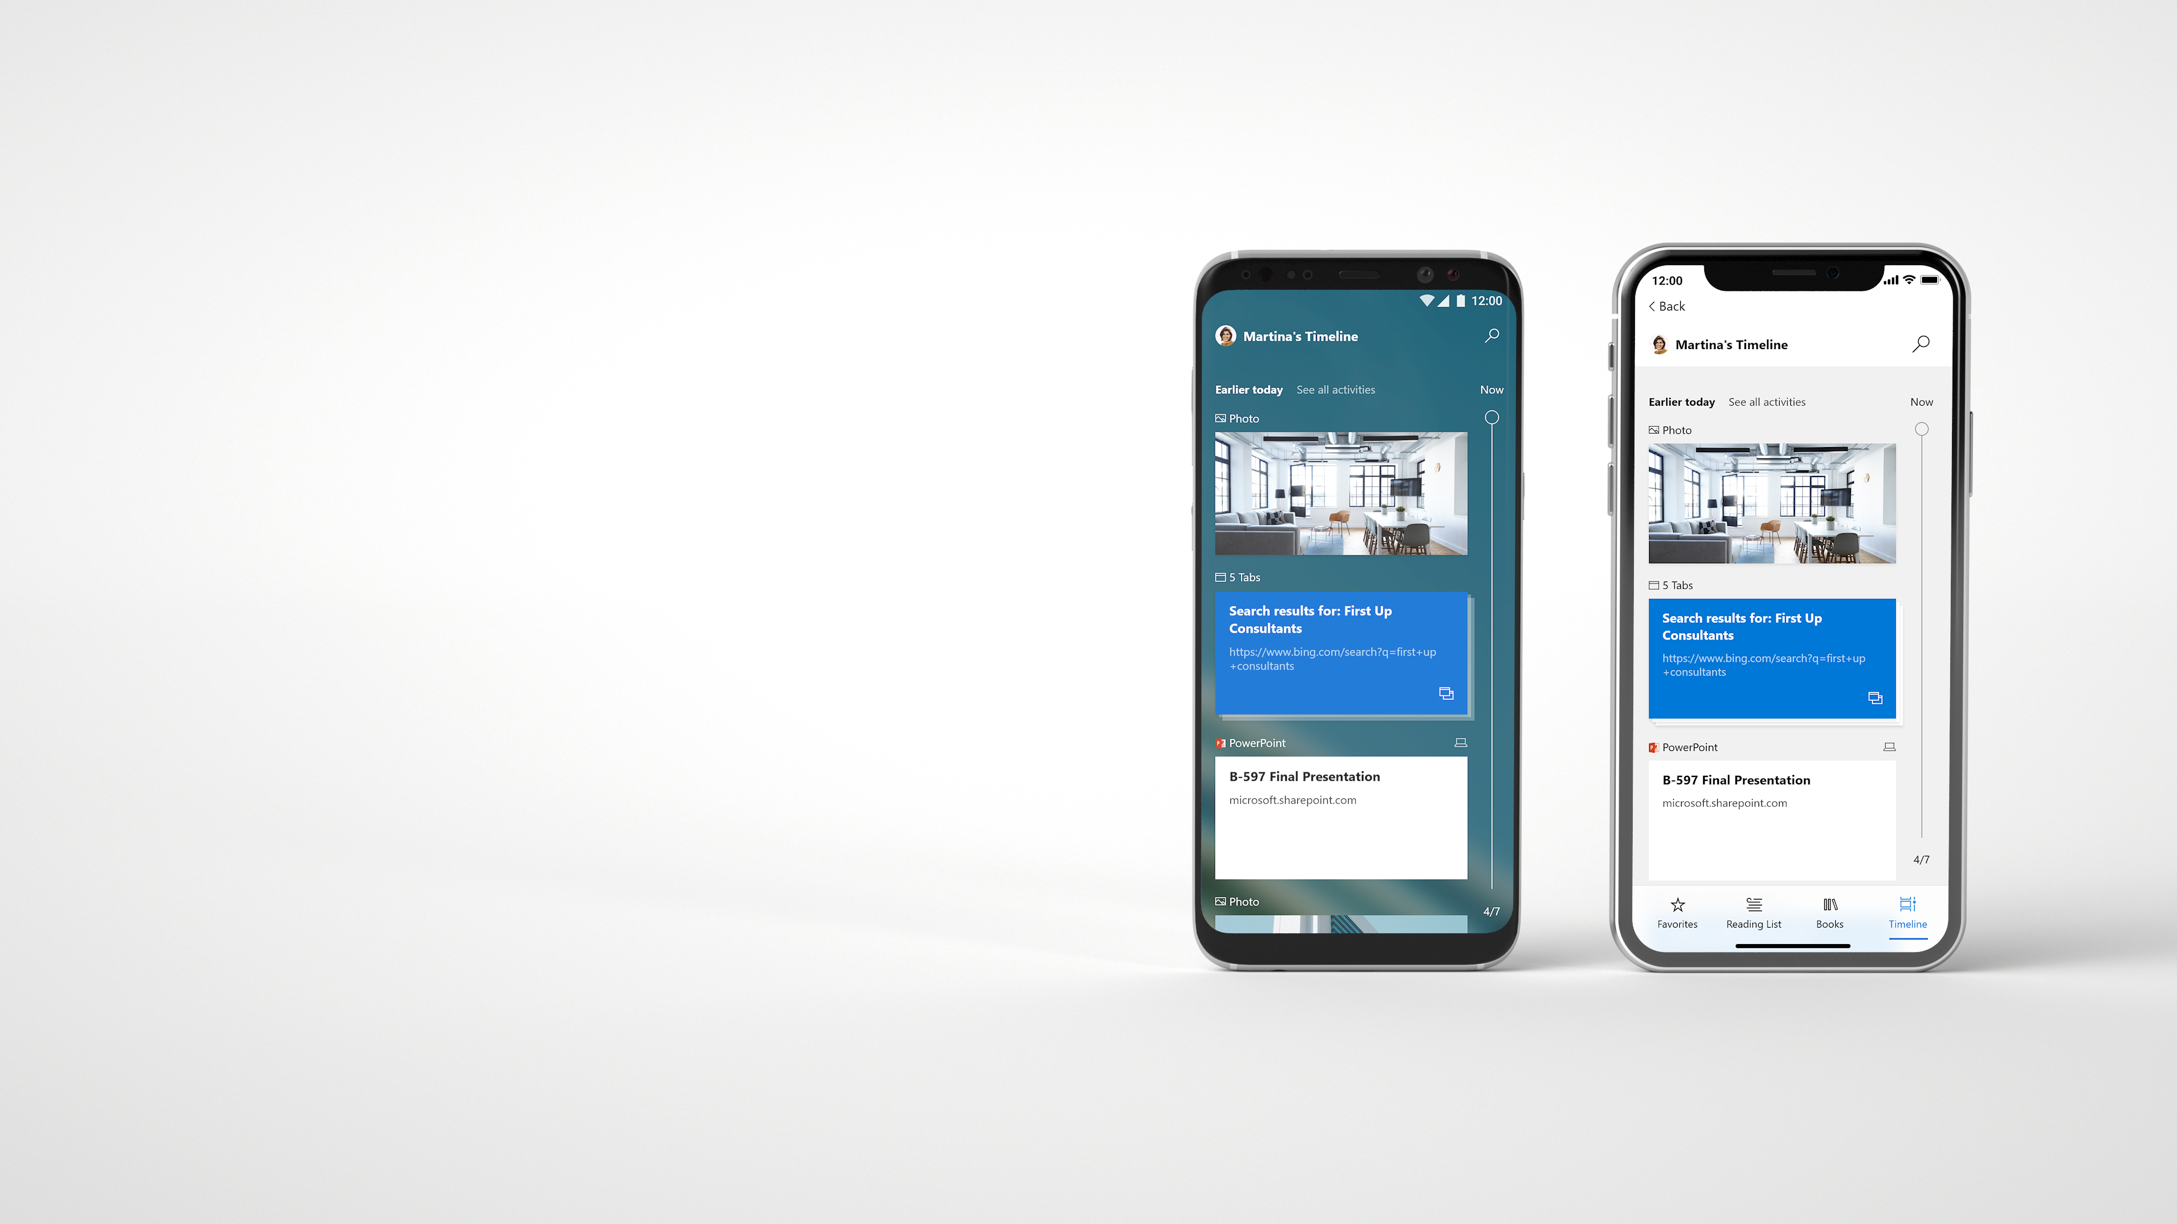


Announcing
Timeline on Phone
Jump back into your activities on any Windows 10 devices, iPhone, and Android phones
Microsoft Launcher
Android
Microsoft Edge
iOS
Notes:
Now, I’m excited to announce that Timeline, is coming to your phone soon.

Slide 31

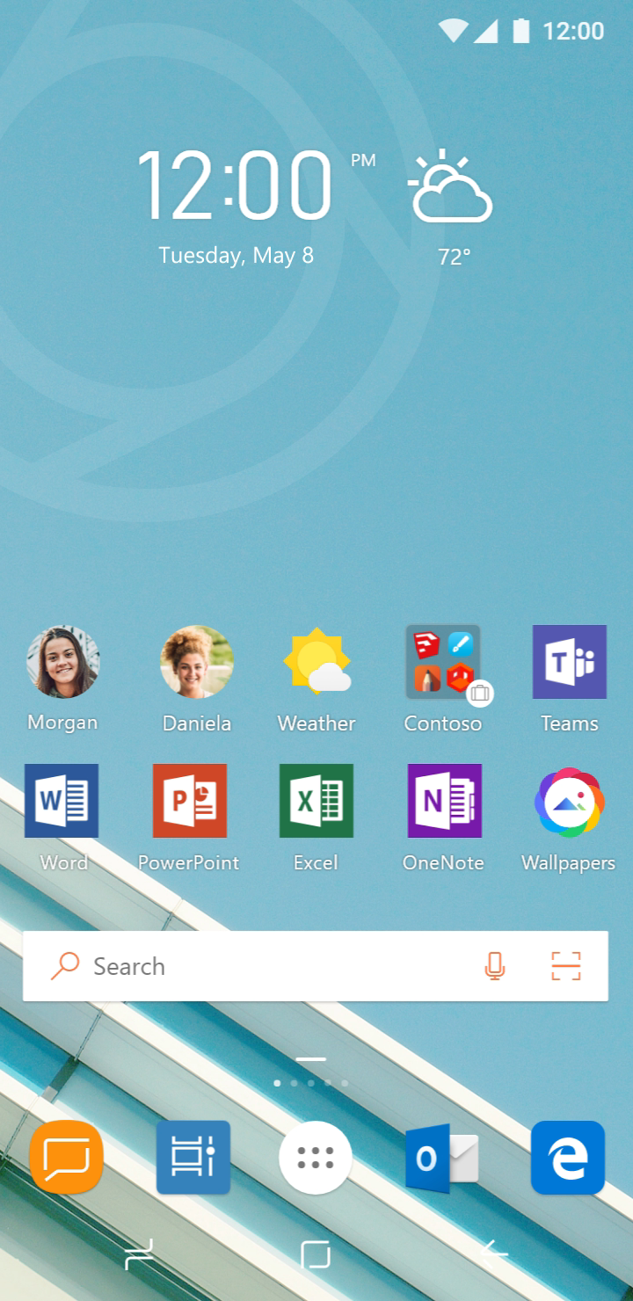

Slide 32
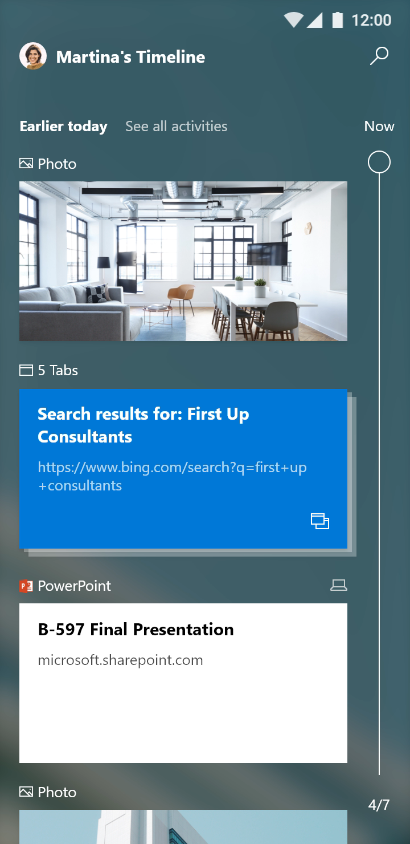
Notes:
Same rich & powerful timeline she has on her PC​
Launch apps​
Search & easily recall activities she did yesterday on her PC​
​
​
​
​

Slide 33
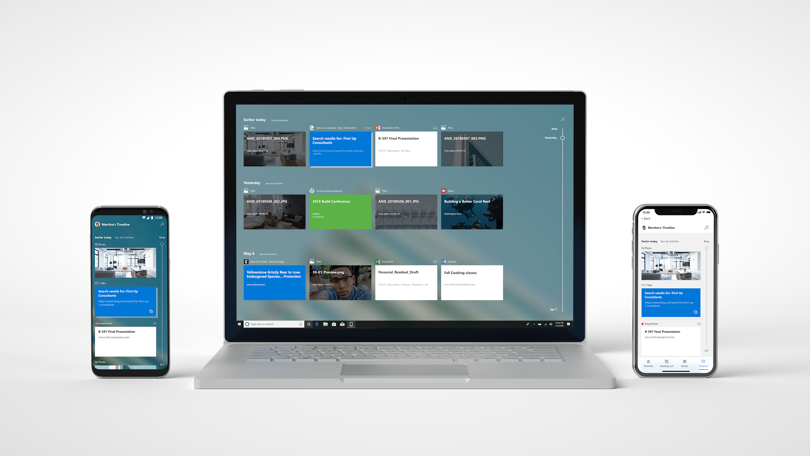
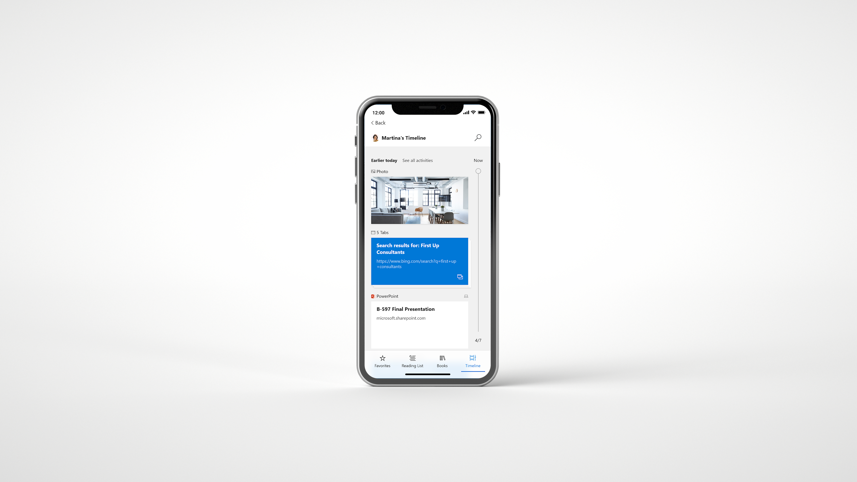
One Timeline. All your devices.
Android
Windows
iOS
Notes:
- Timeline runs across all your devices, Android, iOS and Windows.
​
​

Slide 34
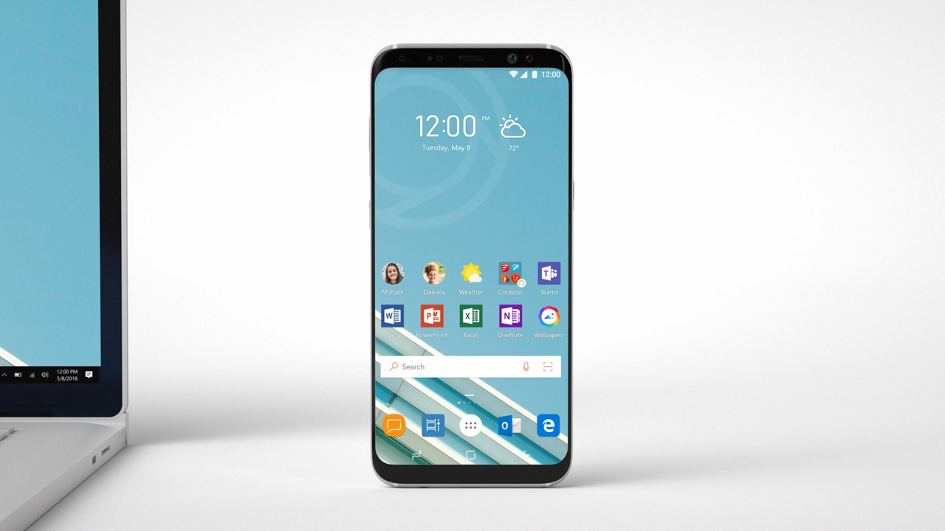
Notes:
Another example…

Slide 35
Insert Timeline Phone Video 1 Here
Notes:
An Android device that receives a text message. That same message appears a notification on Windows 10.
Leveraging Microsoft technology and the user permissions, we can create a durable connection and can access text messages from the phone

Slide 36
Insert Timeline Phone Video 2 Here
Notes:
- The user can respond to messages
Send pictures from their machine via messages
Use images from their messages on their PC

Slide 37
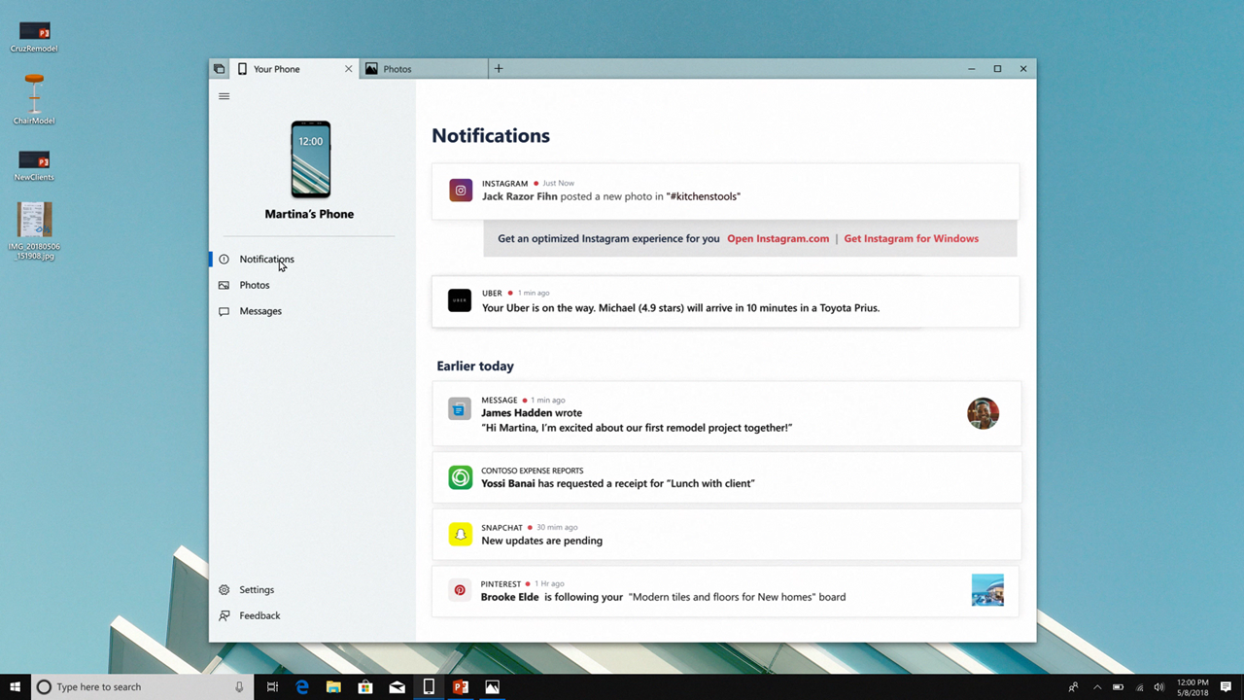
Notes:
The device notifications are also accessible from the Your Phone UWP.
Note that the Contoso Expense Report app is also available on the PC, so you can directly launch the PC version from the phone notification

Slide 38
Insert Timeline Phone Video 3 Here
Notes:
The device notifications are also accessible from the Your Phone UWP.
Note that the Contoso Expense Report app is also available on the PC, so you can directly launch the PC version from the phone notification

Slide 39
Azure
Stack
IoT Edge
Sphere
AI & ML
Microsoft 365
Apps
Web
Office
Graph
Notes:
Time to cover Microsoft 365. Microsoft 365 is the coming together of Windows and Office to bring this multi-sense, multi-device experience. Putting people at the center vs devices at the center.
Apps is about developers with existing apps and how they can modernize. It is also about app devs that are looking to build new applications.

Slide 40
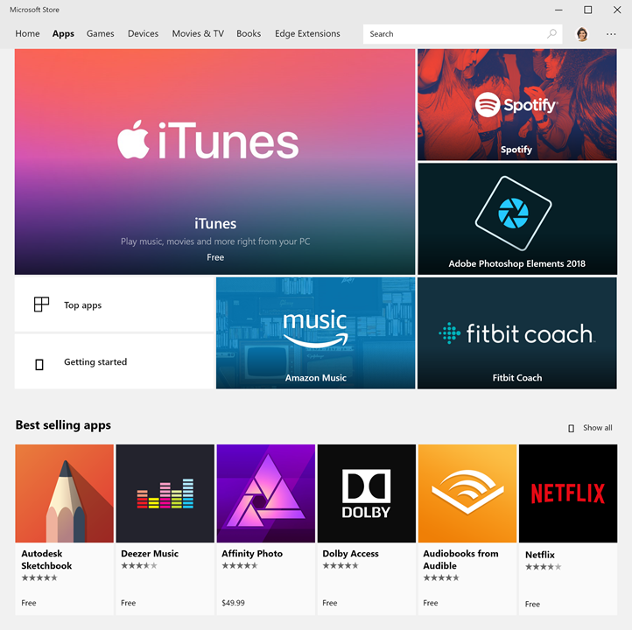
Microsoft Store
Safer & more reliable for customers
Better distribution & discoverability
for developers
Notes:
Why Store Apps?
Store apps are safer & more reliable
Extend distribution and reach to gain new customers
We want to improve on that experience

Slide 41
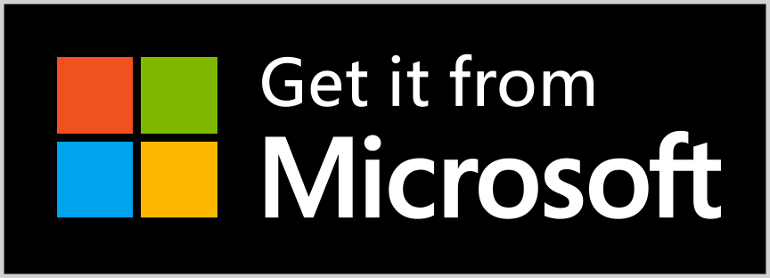
Announcing
95%
New revenue share model
85%
85% when it’s found in the Microsoft store
95% when you direct your customers to your app in the Microsoft store
Developer revenue
Notes:
Announcing - A new revenue share model for consumer apps<click>.
If we bring you the customer you will receive 85% of the revenue,
If you are doing the work to drive customers to you store app then you will now receive 95% of<click>
Aligning incentives to create a friendly app store for developers
**NOT FOR GAMES
**Available later this year

Slide 42


Announcing
MSIX Packaging Tool
MSIX
Convert your entire application catalog
Command line, script, or full UI for automation
Notes:
We’ve also heard feedback from developers that
a) They want to leverage the same capabilities of the UWP packaging and security model in Win32 apps
b) They want to be able to deploy the apps across multiple channels, including sideloading inside enterprises
MSIX is a complete containerization solution.
MSIX inherits all the great features from UWP including reliable, robust installation & updating, a managed security model, and support for both enterprise deployment and the Microsoft Store.
We’re also making it easy for you to take any app or game packaged as MSI and easily up-level it to MSIX.

Slide 43


Announcing
UWP XAML Islands
WinForms
WPF
Win32
UWP XAML Islands
Fluent Design System
Notes:
We’ve also hard feedback that Win32 developers want access to UWP controls, for example new Edge WebView, or inking support. We are going to make this possible via UWP XAML Islands.

Slide 44

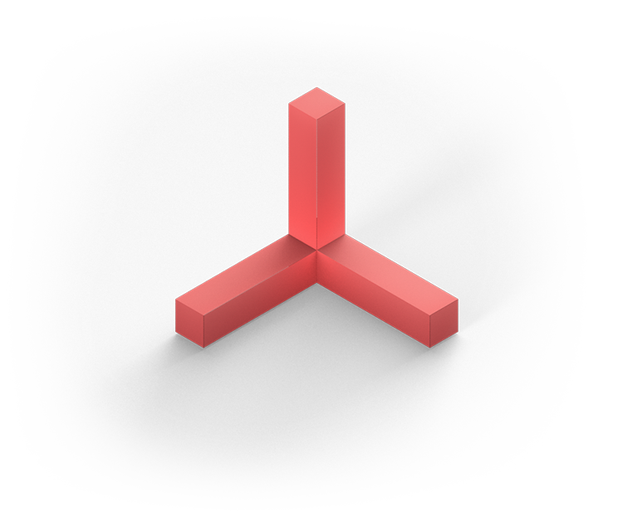
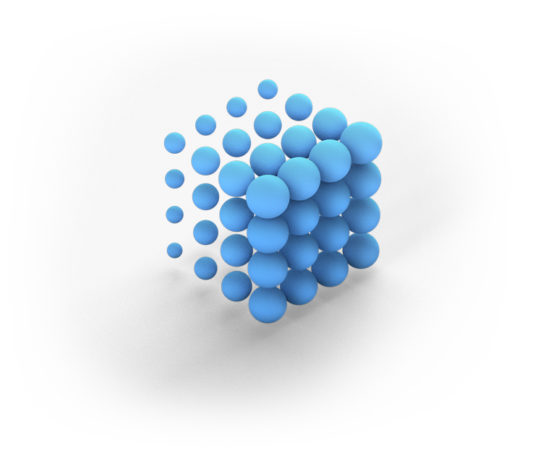
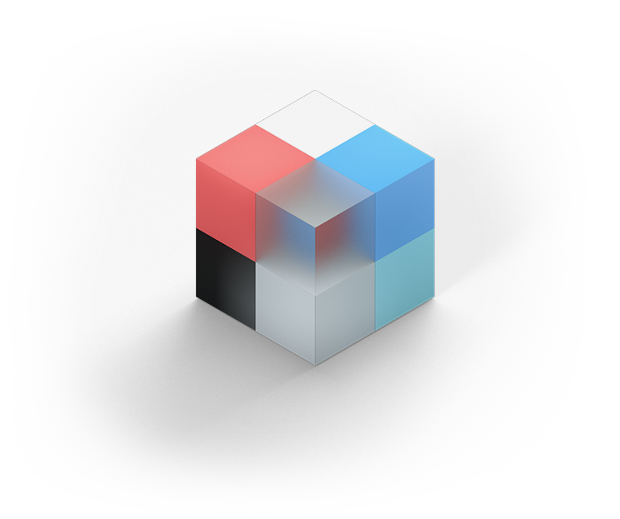

Fluent Design
Light
Depth
Motion
Material
Scale
Notes:
With XAML Island you will also get access over time to more Fluent controls
Fluent can help increase engagement
Let’s take a look at some of the new things coming to Fluent

Slide 45
Fluent Design video

Slide 46
Announcing
Windows UI Library
Native platform controls
Anniversary Update and newer
WinUI
Notes:
- Starting this year Microsoft will begin making many of the new platform controls available via NuGet.
We call it the “Windows UI Library” or “WinUI” for short.
Controls in WinUI are the same ones that ship in the platform and the same ones that Windows uses to build its apps and experiences.
But now, if you’re deploying to devices running Windows 10 Anniversary Update or later, your application can start using WinUI controls right away.
​

Slide 47

Announcing
Windows Community Toolkit 3.0
50+ controls, 60+ helpers
aka.ms/windowstoolkit
Windows Community
Toolkit 3.0
Notes:
Full partnership between the community and Microsoft on GitHub
Version 3.0 is out now featuring new controls for UWP, WinForms and WPF.
Over 100 community contributors
http://aka.ms/windowstoolkit

Slide 48
Windows Community Toolkit 3.0
Demo

Slide 49

Announcing
.NET
Core 3.0
3.0
Side-by-side
WinForms
WPF
UWP
Notes:
Developers wants code PERFORMS WELL, is PORTABLE, and is MAINTABLE.
With .NET Core 3 Microsoft are bringing support to new device types including AI, IOT, and DESKTOP.
.NET CORE for DESKTOP means you NO LONGER need a DEPENDENCY on the .NET FRAMEWORK installed on the machine – you ship what you need.
.NET CORE has a smaller footprint and IMPROVED PERFORMANCE. .NET CORE also supports a more MODERN .csproj PROJECT SYSTEM.
You can now run multiple instances of .NET Core 3 side-by-side on the same computer, which means you can update Windows Forms, WPF, and UWP applications to a new version of .NET without updating the entire system.
This will be released in 2019 but you can begin using preview builds this Fall.

Slide 50
Azure
Stack
IoT Edge
Sphere
AI & ML
Microsoft 365
Apps
Web
Office
Graph
Notes:
Microsoft made a lot of investments on the Web

Slide 51
New in ASP.NET Core 2.1
SignalR
[ApiController], ActionResult<T>
Razor class libraries
IHttpClientFactory
Identity UI library & scaffholding
Kestrel on Sockets
HTTPS
Generic host builder
GDPR
Performance
MVC functional testing
Updated SPA templates
Notes:
- ASP.NET Core 2.1 now has a lot of new features.
It’s GDPR compliant
SignalR has launched

Slide 52
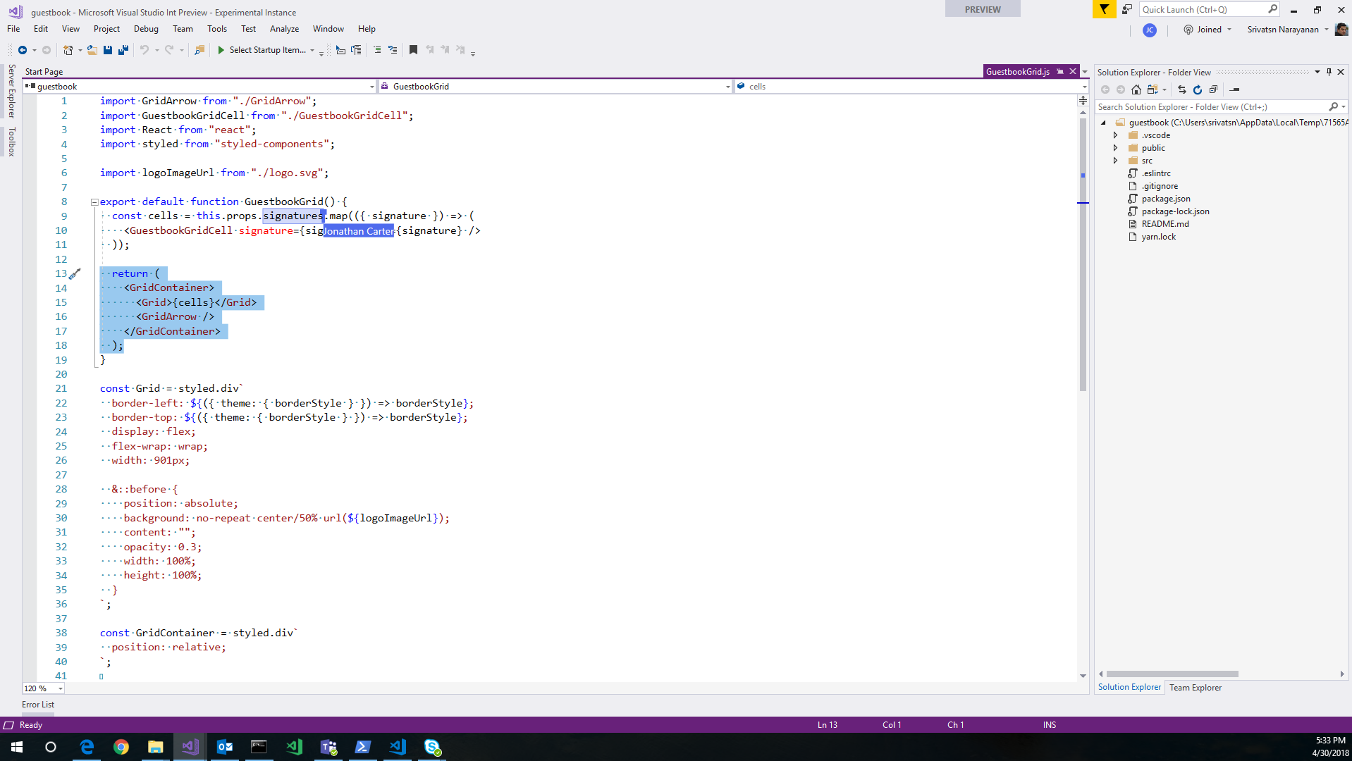

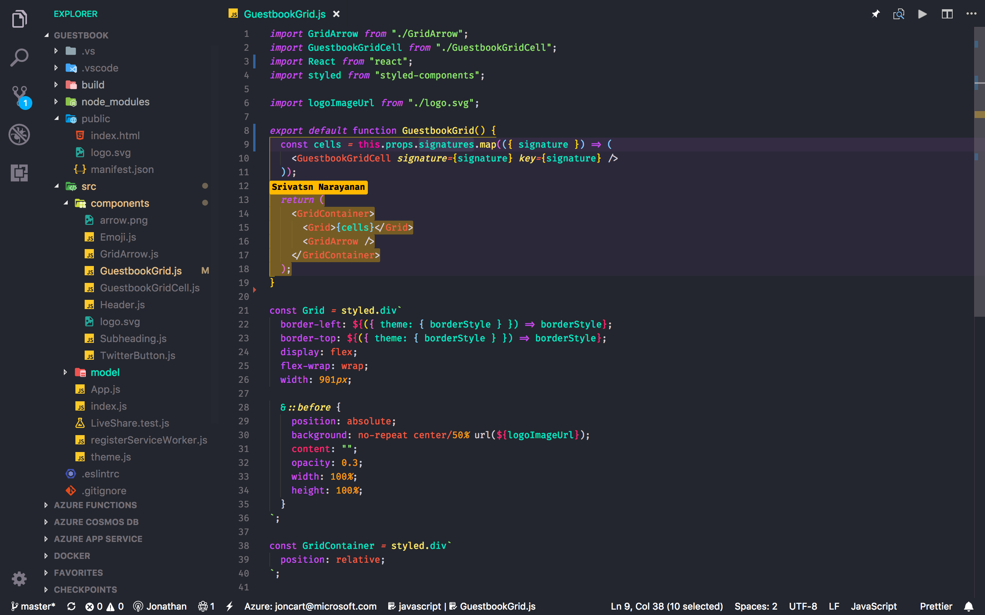
G
Visual Studio Live Share
NEW
Real-time collaborative development
Shared debugging, independent views
Works across Visual Studio and Visual Studio Code
Notes:
Hands up if you use Visual Studio?
Well you are going to love this next feature!
Visual Studio Live Share allows for a real-time collaborative development.
This is not just editing code together, it includes debugging too.

Slide 53
Visual Studio Live Share
Demo

Slide 54

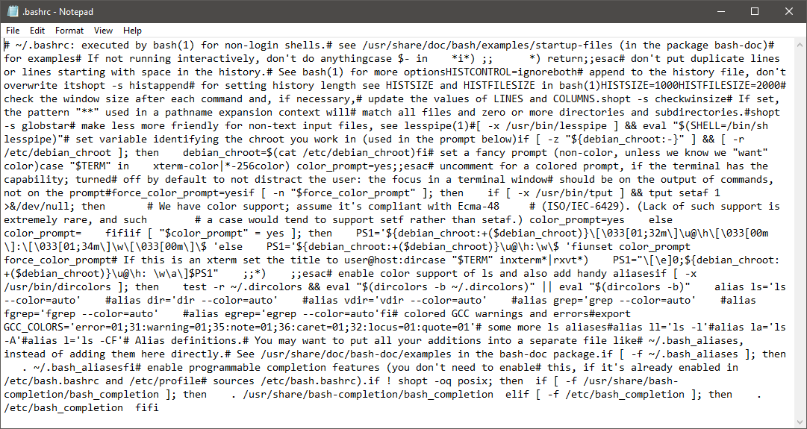
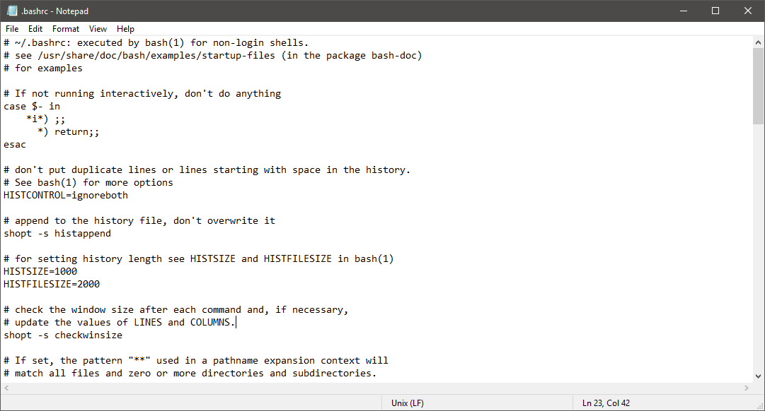




Hyper-V
Android emulator
Notepad
Line feed
Notes:
But, to me sometimes, it’s the little things that matter the most.
Like how in Notepad Linux line feeds don’t actually end and just go on and on….I can work past it, but it’s just plain annoying.
So, we fixed Notepad! Notepad now supports the Linux line feeds.
​
​

Slide 55
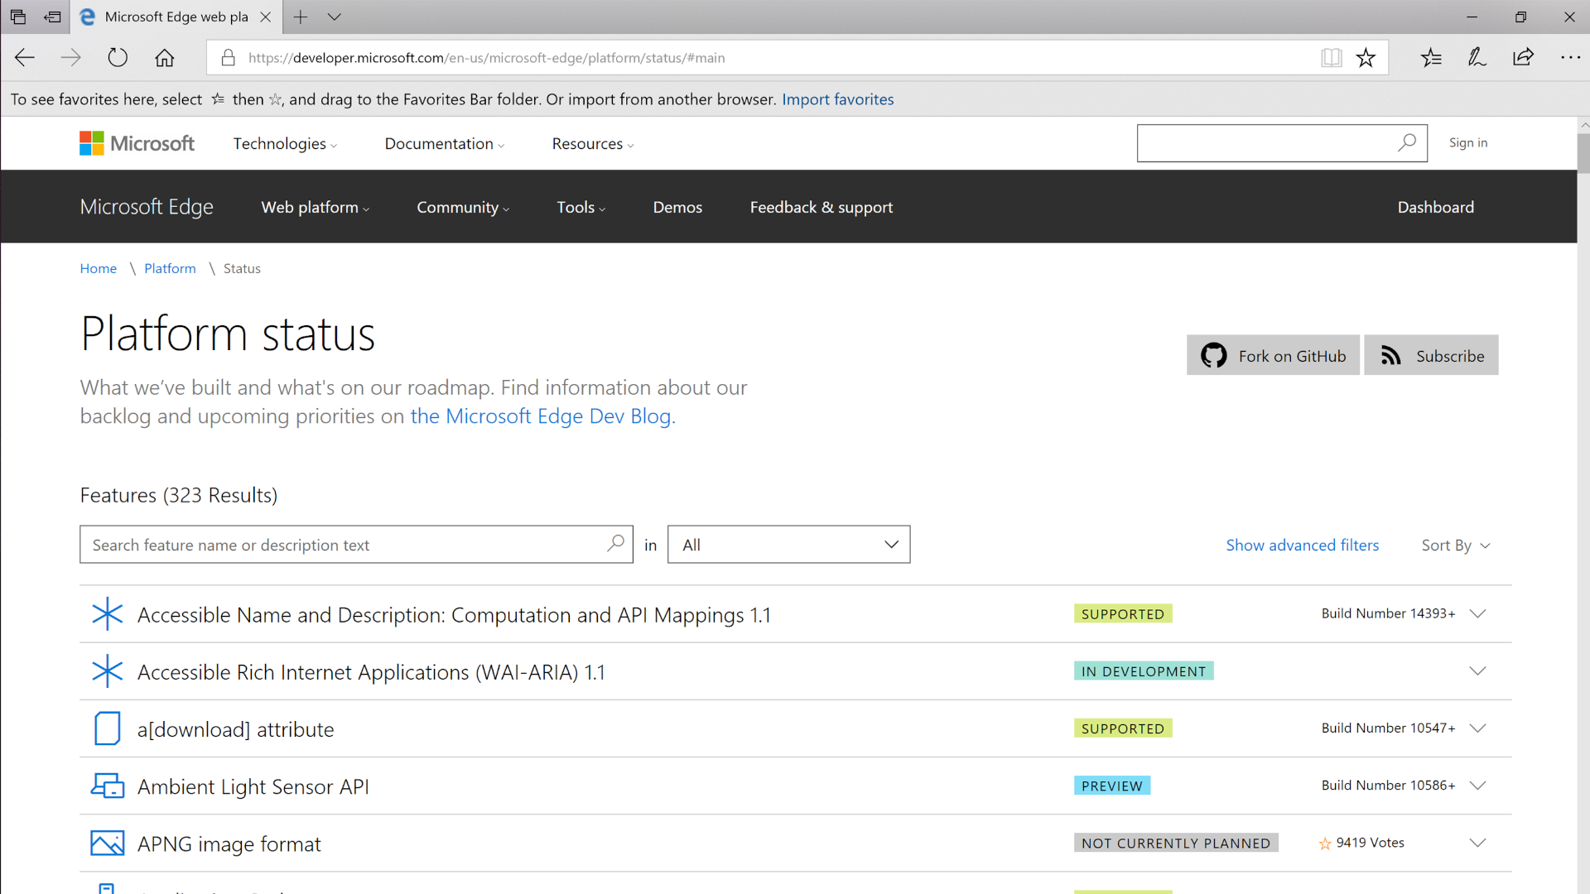
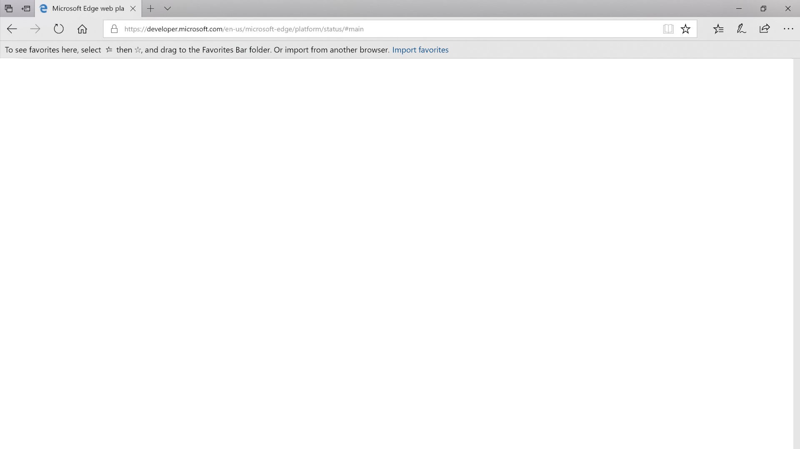
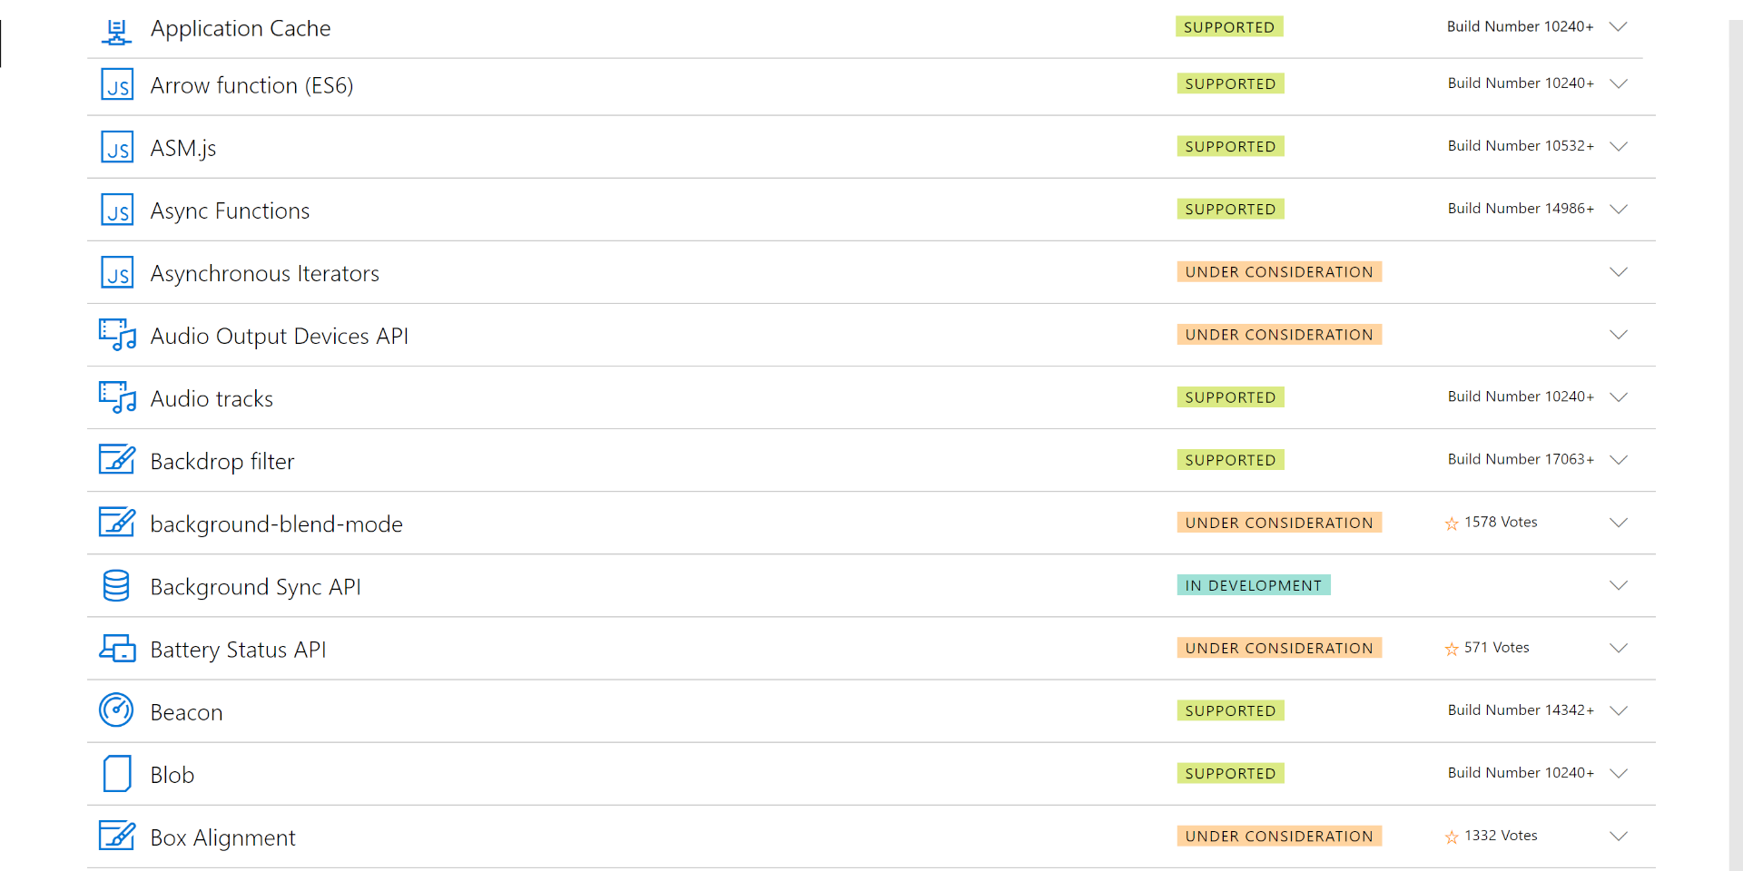
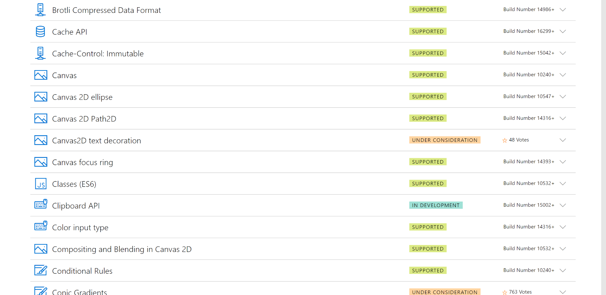
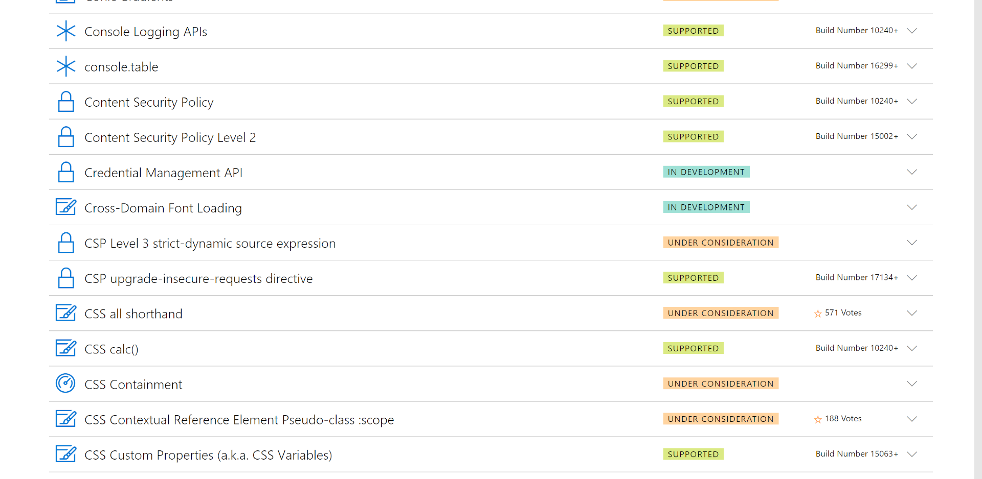
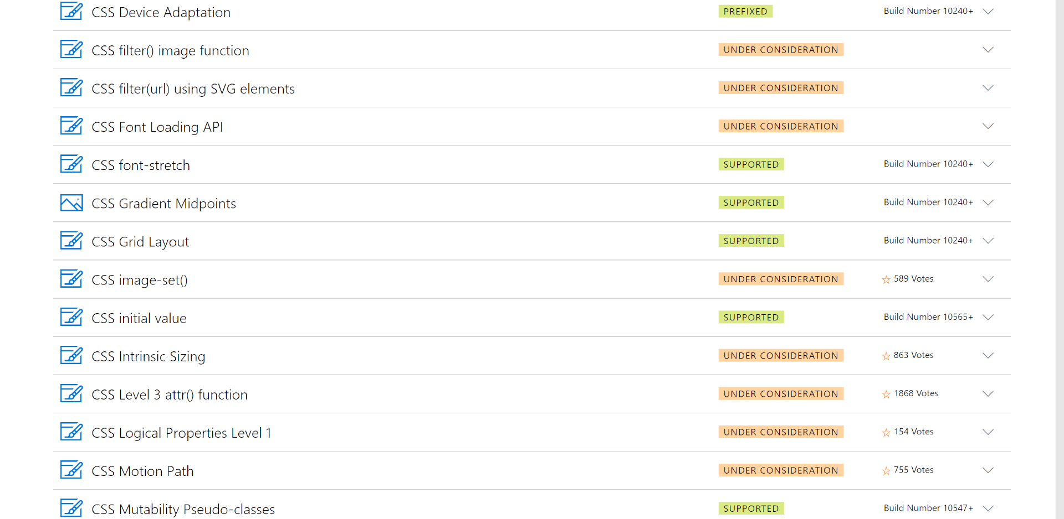
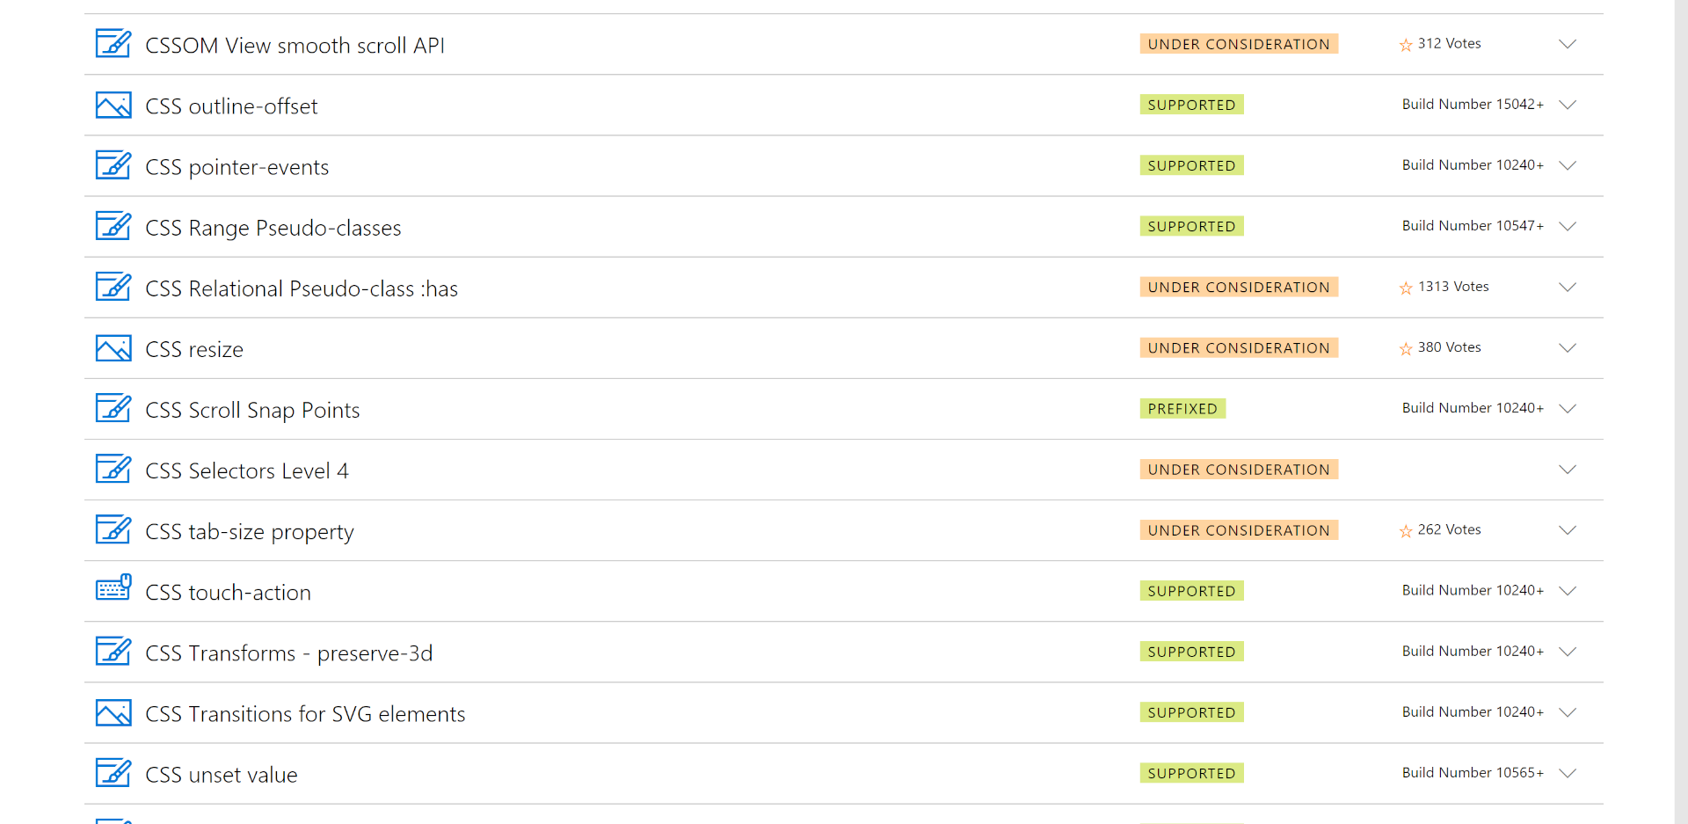
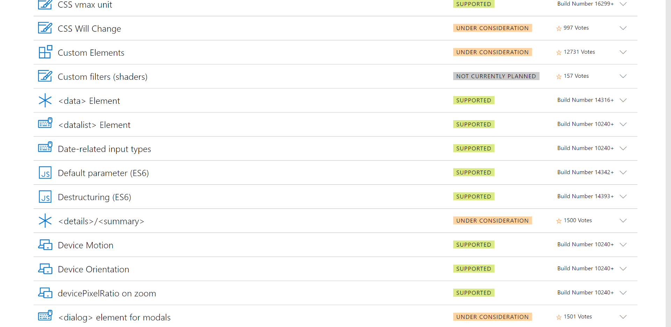
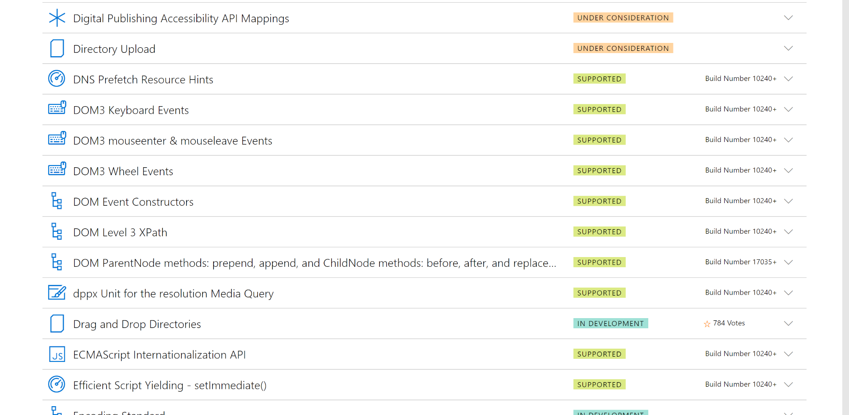
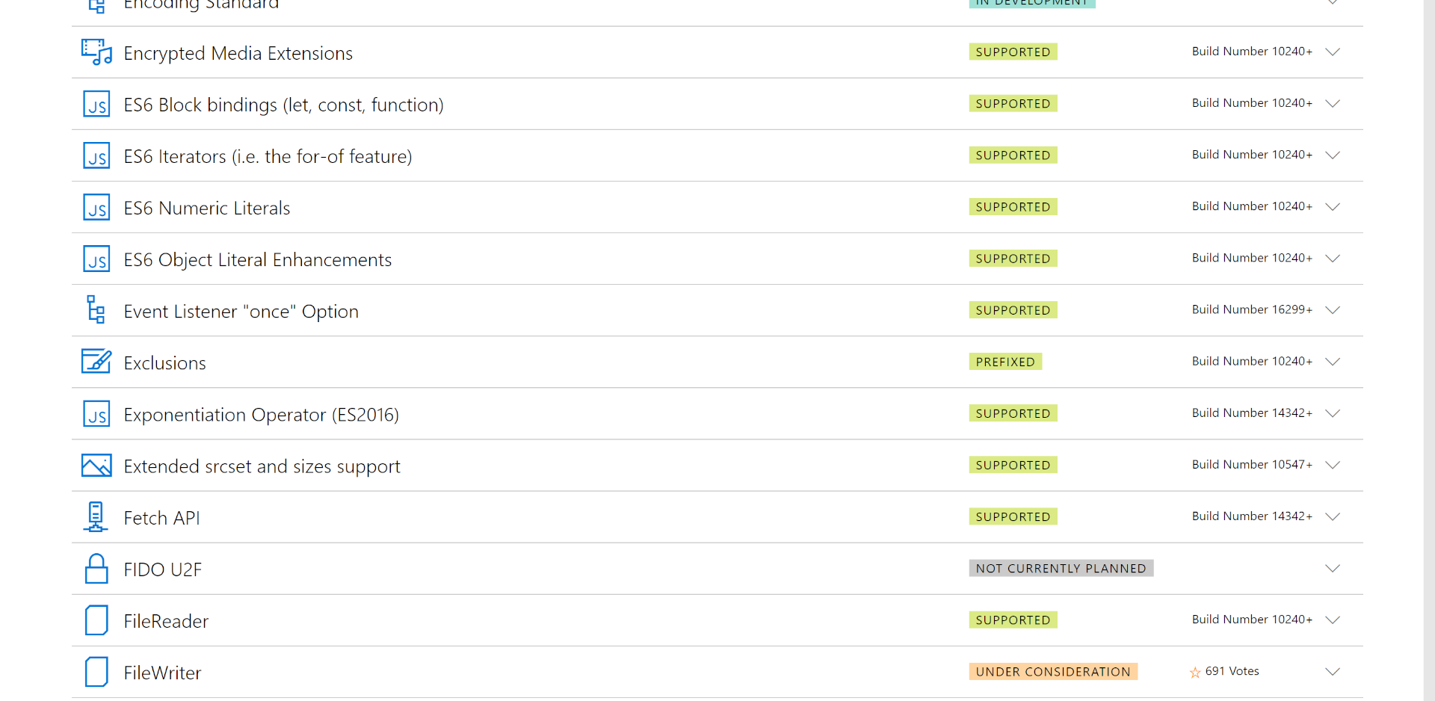
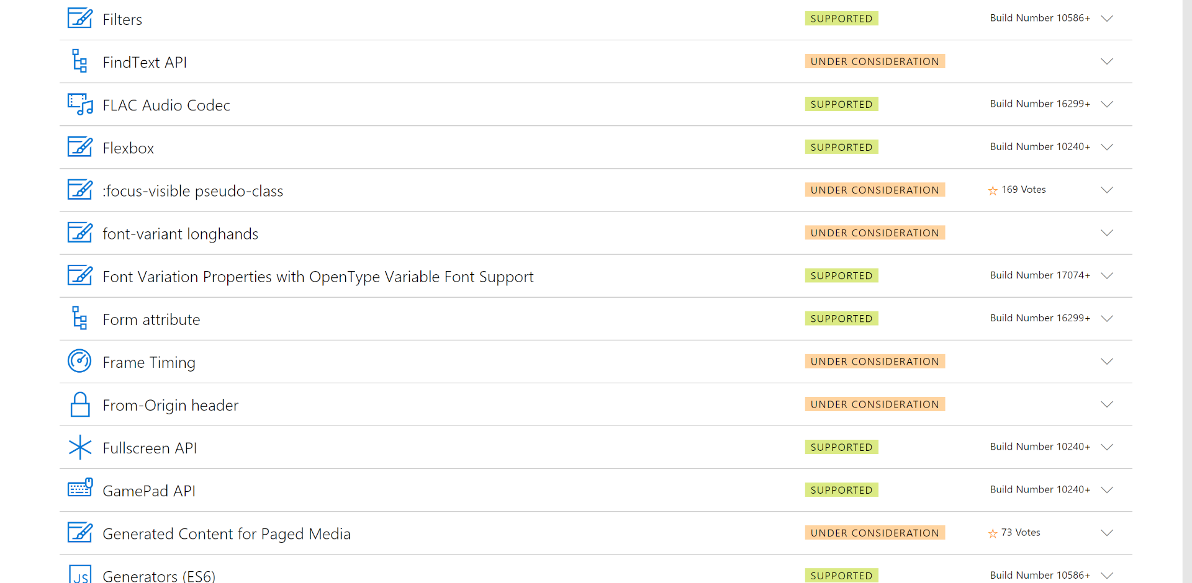
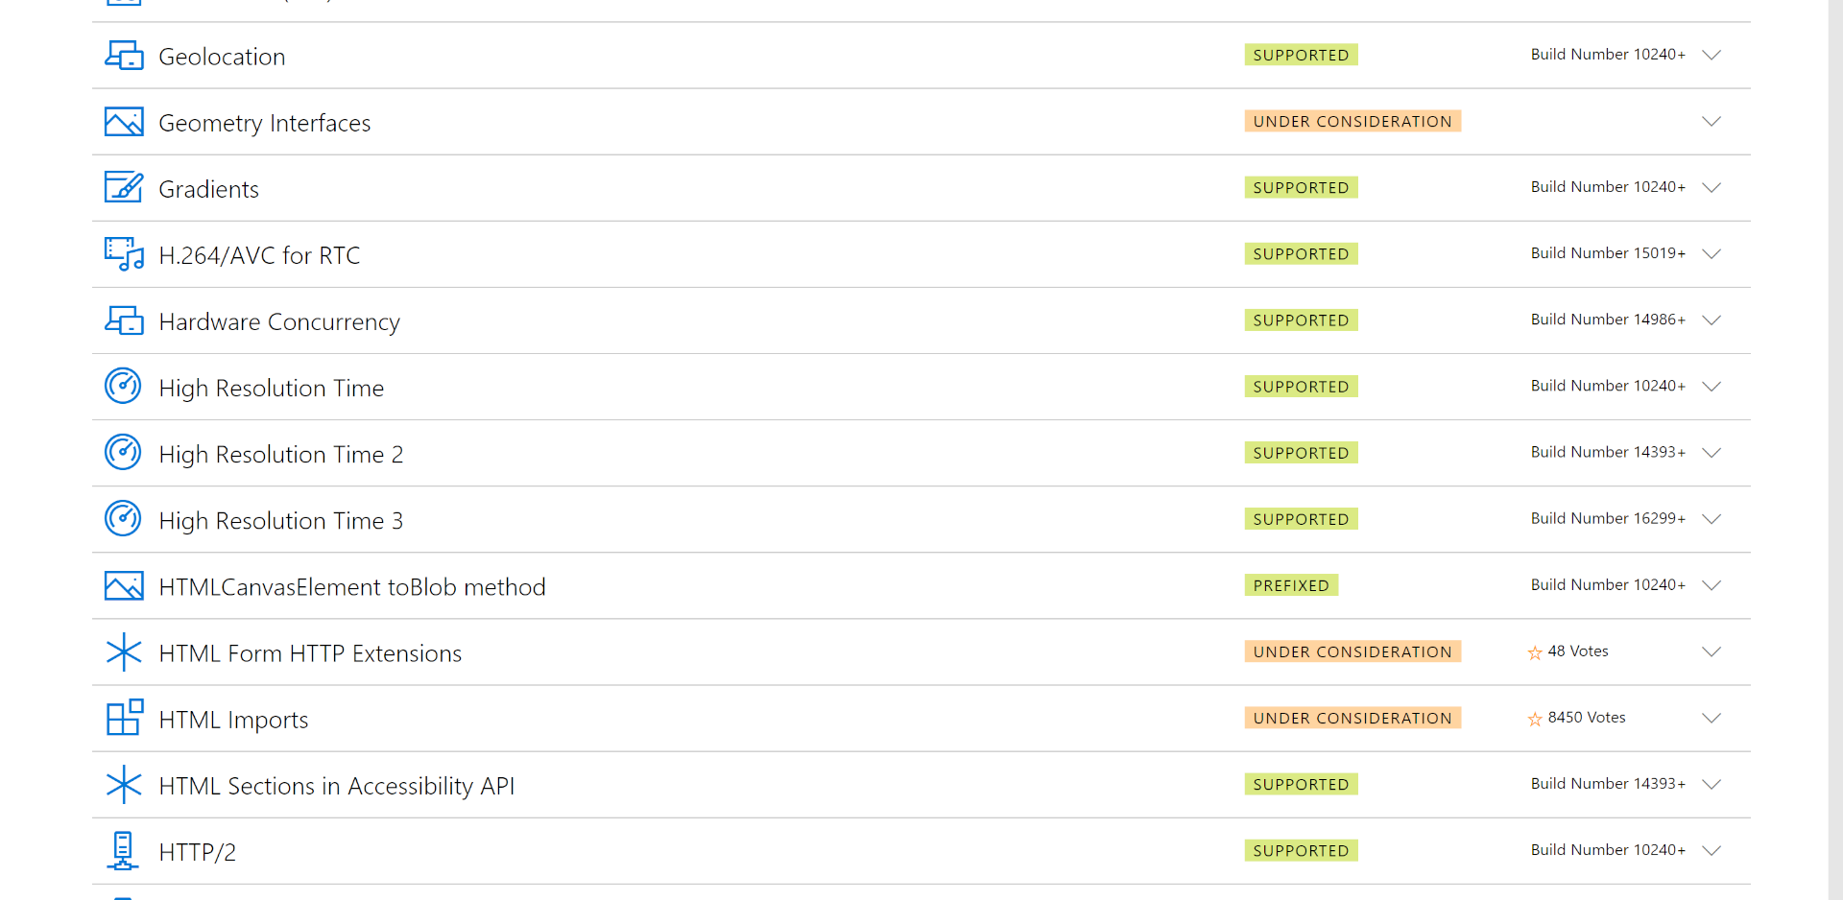
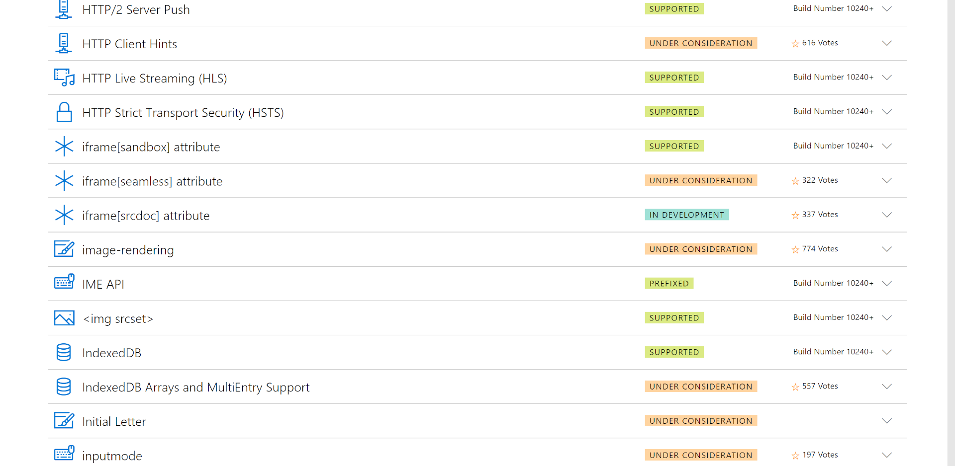
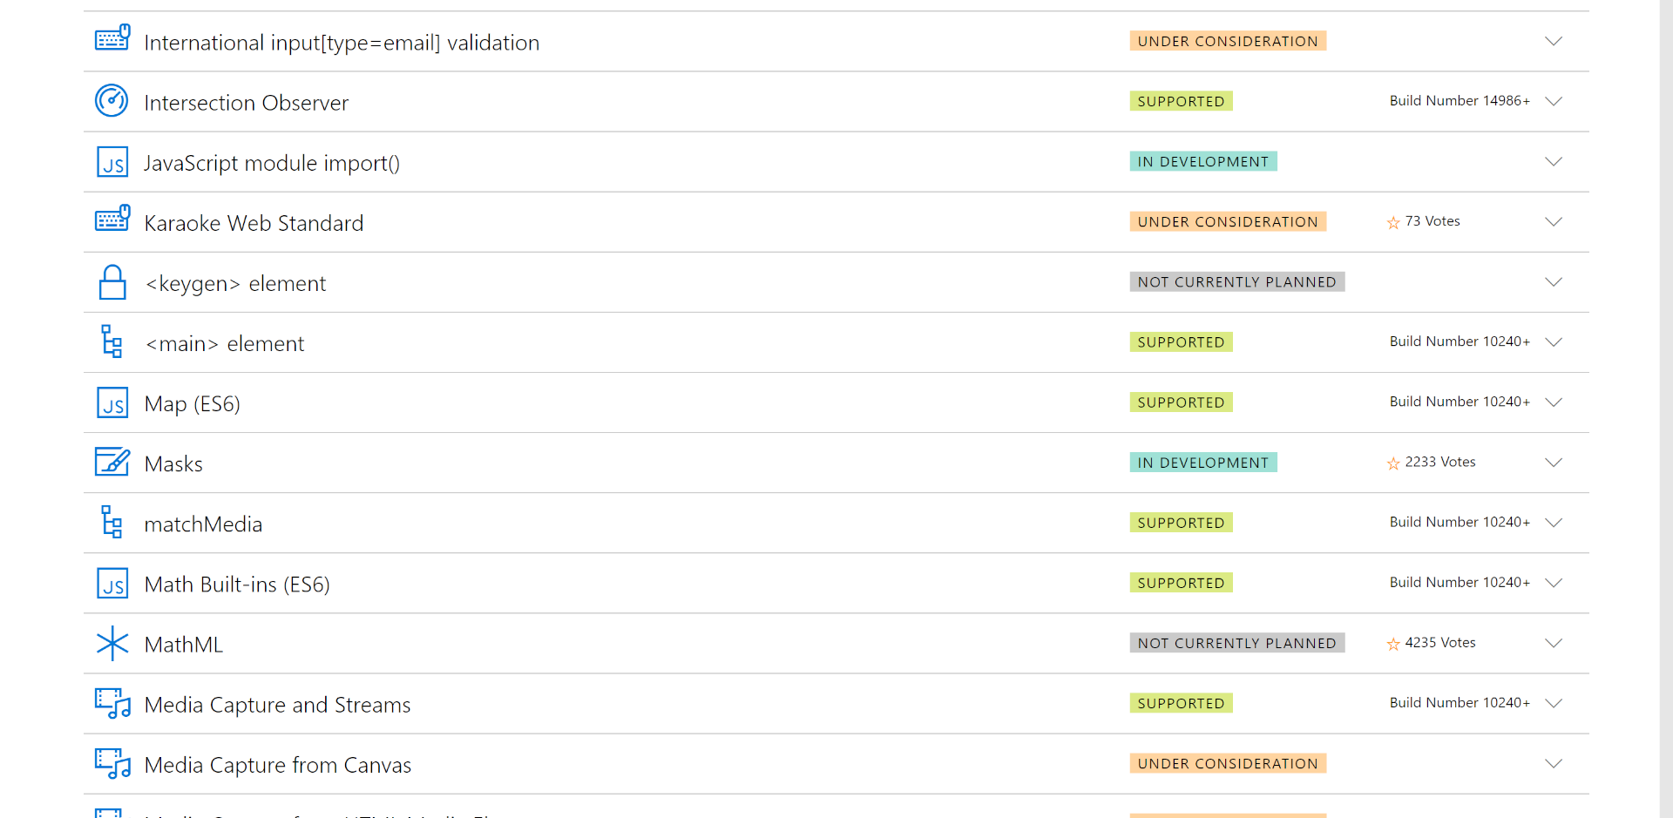
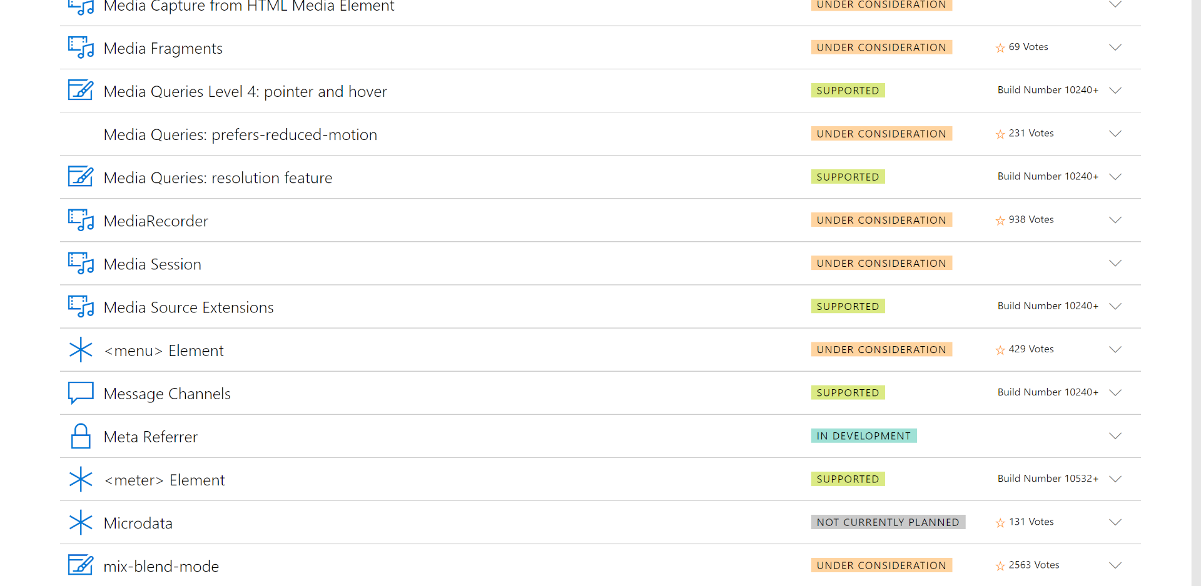
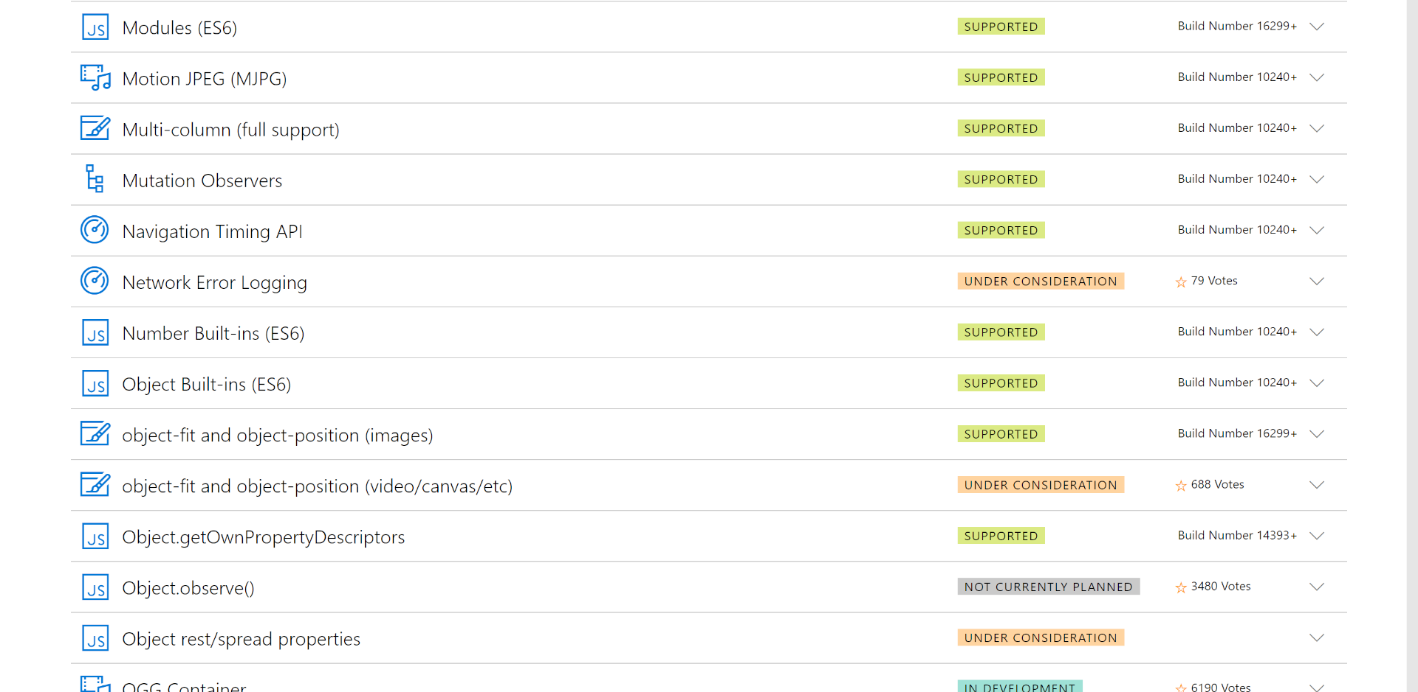
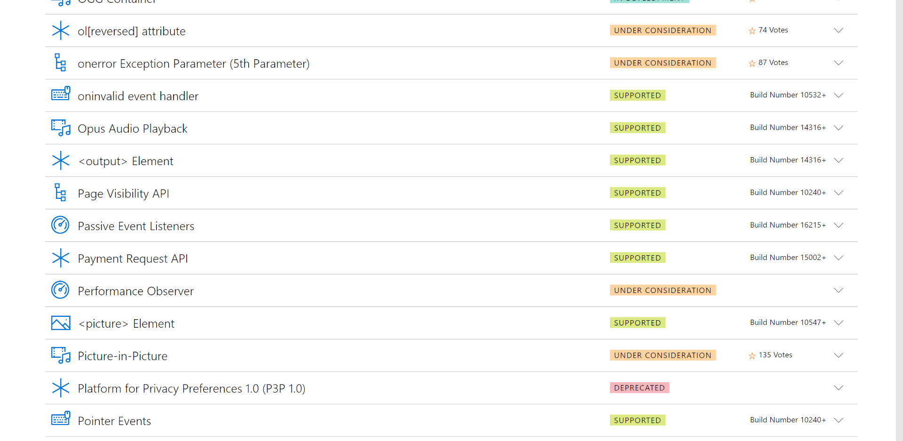
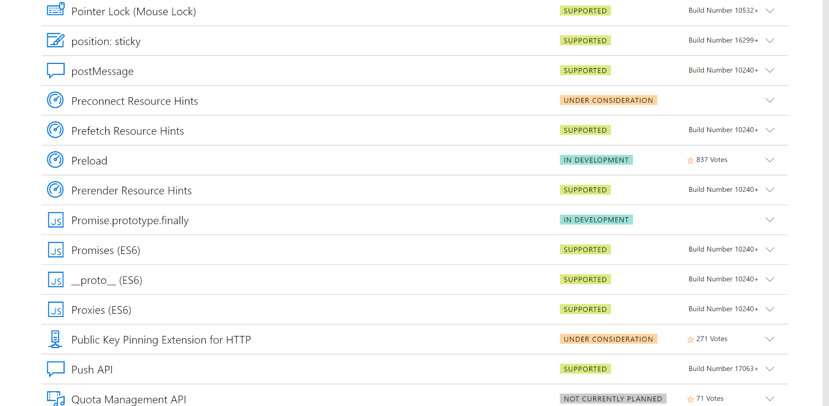
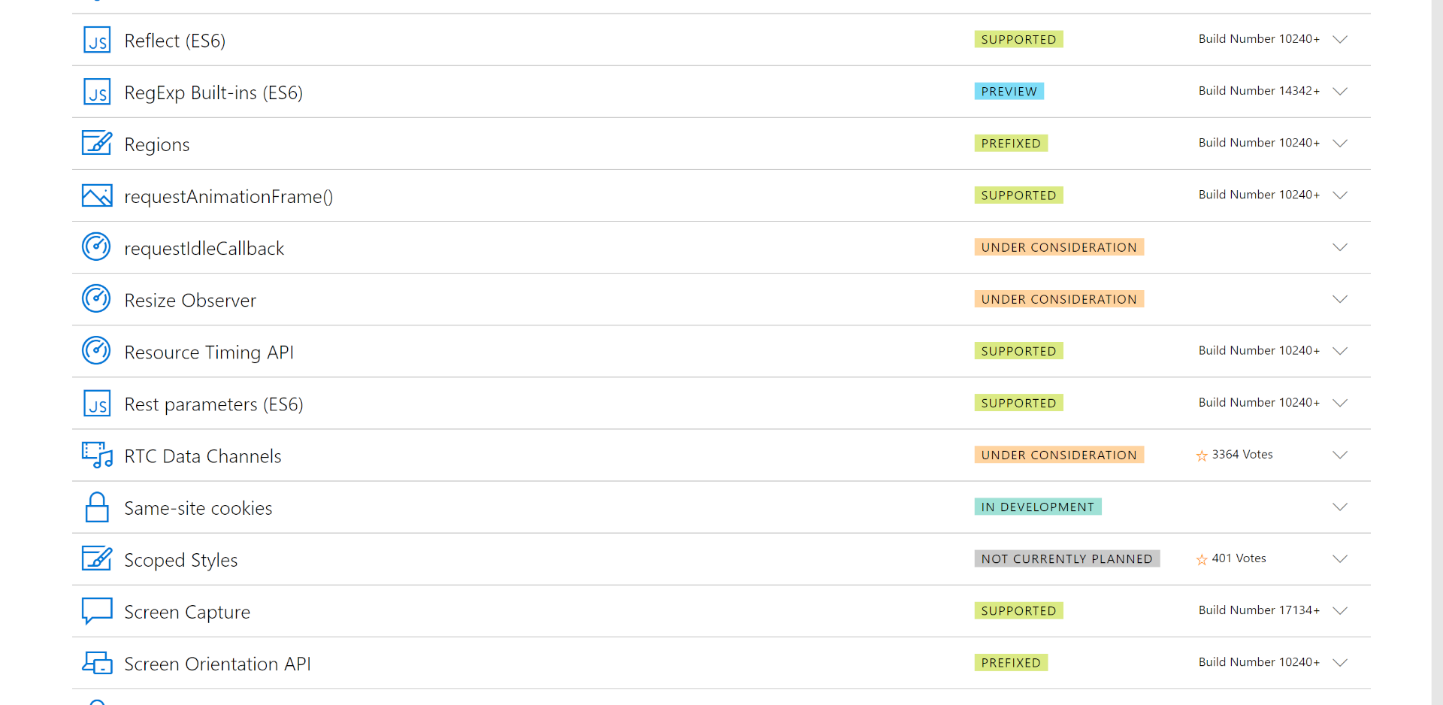
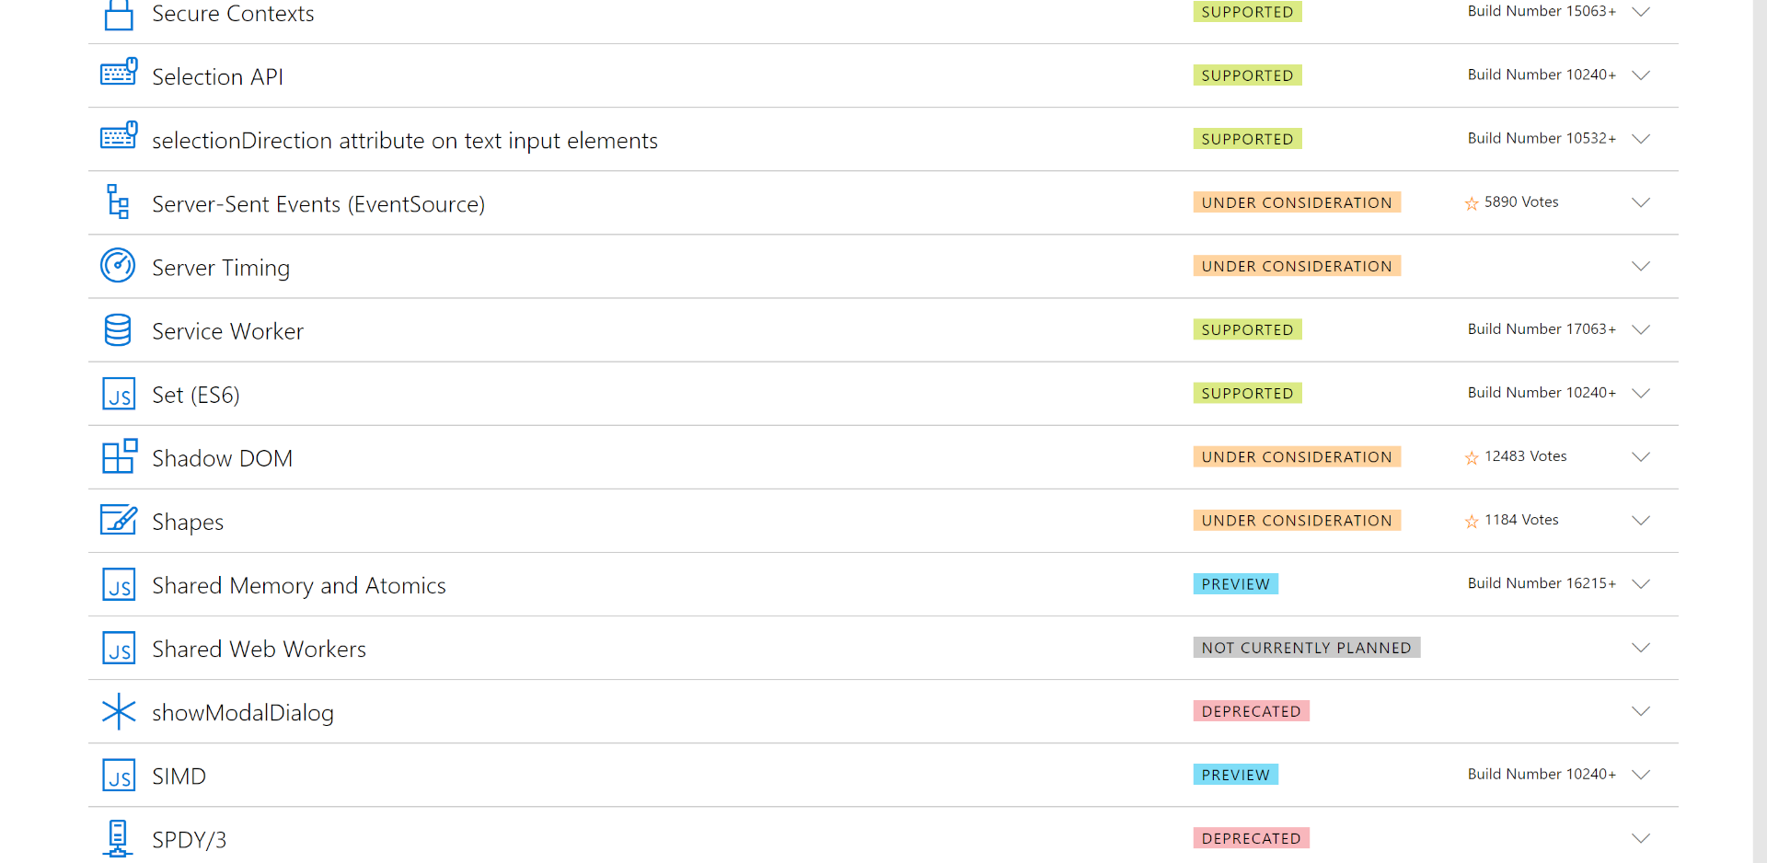
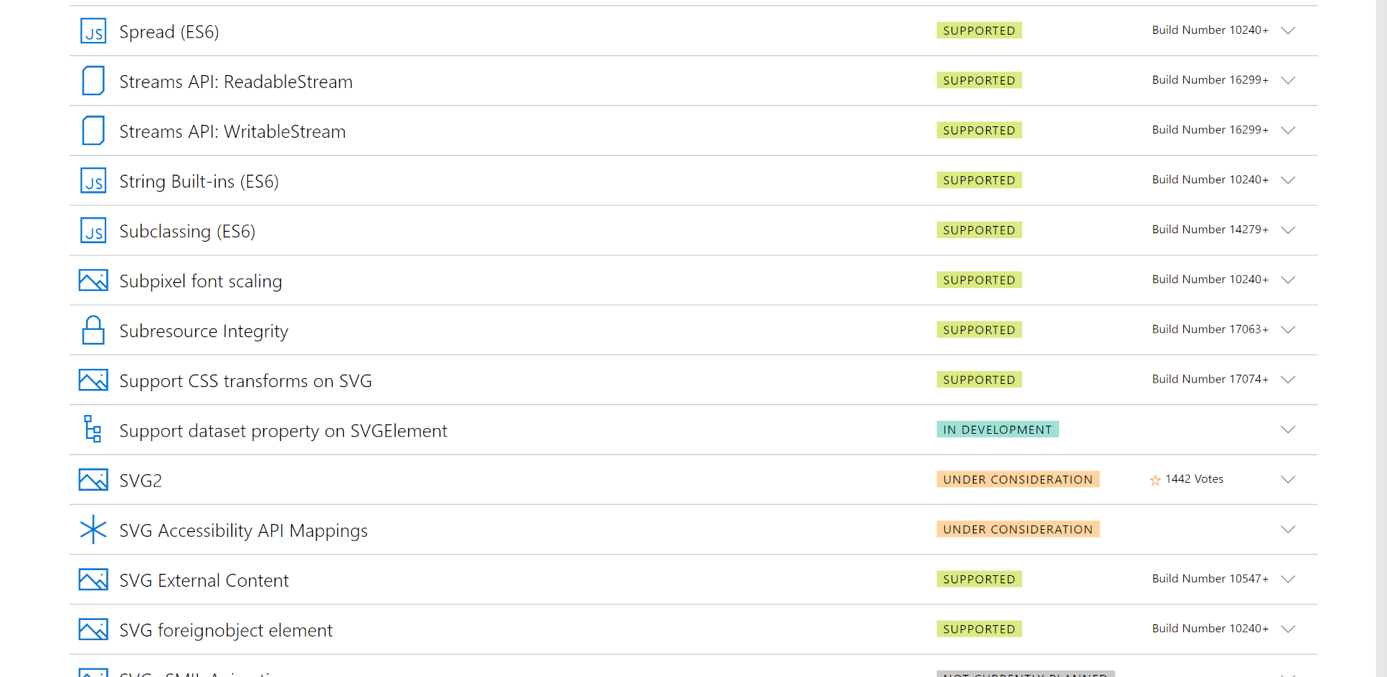
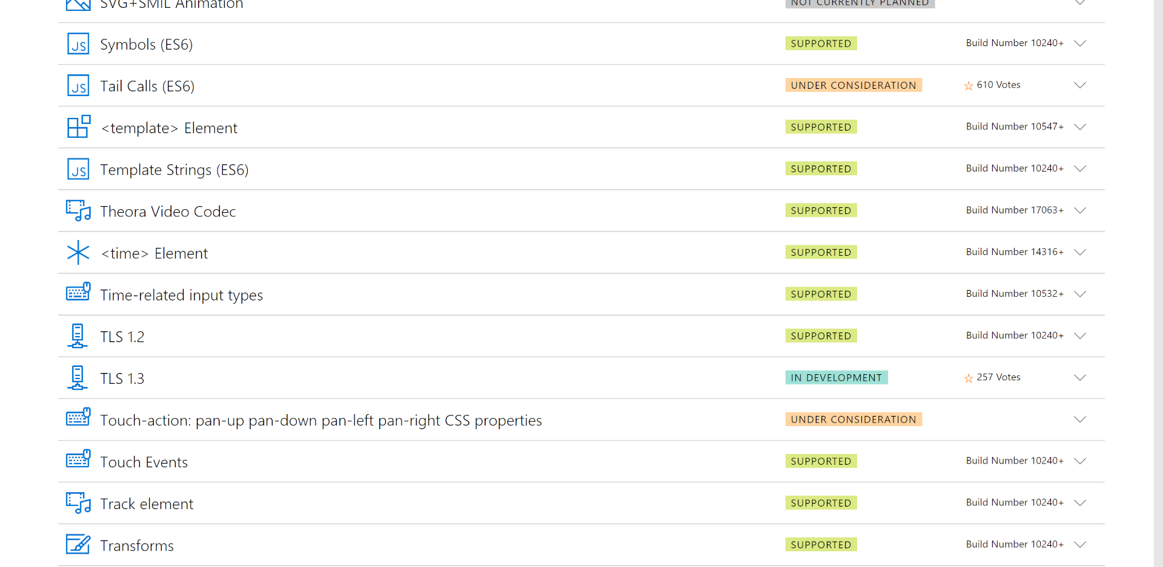





Notes:
Whether you a VS or a notepad user, as a web developer we are making a ton of investments.
The Edge team expose their backlog online where you can review progress.

Slide 56

Notes:
Example of Twitter creating a PWA

Slide 57

Notes:
Discoverable through Edge and the Store

Slide 58

Notes:
App recognize user as cookies are now shared with Edge

Slide 59

Notes:
Utilizing Windows APIs to create rich features that the web doesn’t offer

Slide 60

Notes:
Pin User to Start menu

Slide 61


Slide 62

Notes:
- Show pinned tile on Start menu

Slide 63

Notes:
- Normally Twitter renders in a light theme on the web, as shown here in the PWA

Slide 64

Notes:
- Now adding dark theme to the PWA so users have choice as to show they prefer to view the experience

Slide 65
Notes:
- Twitter also has deep integration with the Windows Shell
- The user can use the Taskbar Jump List to start a new tweet.

Slide 66

Notes:
- Twitter also has deep integration with the Windows Shell
- The user can use the Taskbar Jump List to start a new tweet.

Slide 68
Azure
Stack
IoT Edge
Sphere
AI & ML
Microsoft 365
Apps
Web
Office
Graph
Notes:
A key part of the Microsoft 365 platform is Office

Slide 69




Extensions in Office
Notes:
Uses web technologies
Reduces friction
An opportunity to engage more with users meeting in the places they are

Slide 70
Bots and Adaptive Cards
Demo

Slide 71
Azure
Stack
IoT Edge
Sphere
AI & ML
Microsoft 365
Apps
Web
Office
Graph
Notes:
Bringing together both Windows and Office experiences is the Microsoft Graph

Slide 72
Microsoft Graph
Tasks
Retail
Trade promotion
Talent
Gaming
Email
Shipments
Support case
Message
Creating
Hospital
Orders
Planograms
Patients
City
Relationships
Connecting
Warehouse
Opportunities
Restaurant
Documents
Device Data
People
Skills
Forecast
Accounts
Calendar
Job history
Meetings
Merchandise
Reading
Manufacturing
Service requests
Professional contacts
Writing
Storage
Stadium
Equipment maintenance
| Real world data
Your data | Organizational data | Web data
Notes:
Microsoft Graph is the APIs that Microsoft provide about user data, organizational data, web data and real world data
Bringing this data into your application experience can super charge user productivity

Slide 73
Graph Explorer
Demo

Slide 74
Azure
Stack
IoT Edge
Sphere
AI & ML
Microsoft 365
Apps
Web
Office
Graph
Notes:
- We’ve spent the last 90 minutes talking about our 2 massive platform opportunities. Azure and Microsoft 365.
- Microsoft believes opportunities these platforms provide will empower YOU the developer to achieve more.

Slide 75
Agenda
9:00
Opening Session
2:00
TBD
11:00
TBD
2:30
TBD
11:30
TBD
3:00
TBD
12:00
Lunch
3:30
TBD
12:45
TBD
4:00
Q&A
1:00
TBD
1:30
TBD

Slide 76






Labs
https://aka.ms/insiderdevtour-labs
Notes:
If you’d like to try hands on code some of the tech we will show you today, you will have access to new labs.
You can install the labs offline on your machines, or even run them online – as Microsoft is hosting the labs also on virtual machines
Take a note of the link in this slide…

Slide 77

Microsoft 365 Developer
mi·cro·soft 365 de·ve·lo·per noun
a Windows developer who added modern skills to their toolkit
a person that leverages the Graph, Windows and Office to deeply engage with their customers
a person that develops for Microsoft 365
Notes:
M365 Developer Definition – MSFT Mission
- After completing the labs, you can officially say you are truly a Microsoft 365 developer.

Slide 78
TBD

